Slide 2
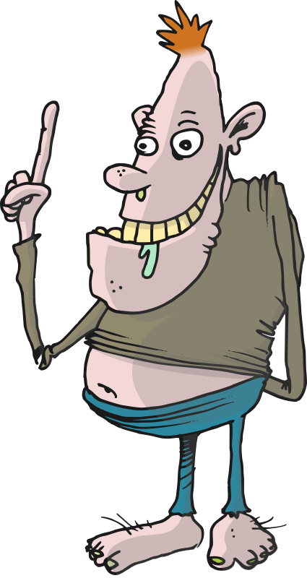
damprat

Slide 3
damprat
By now I’m certain you’re thinking that “damprat”, pronounced “dumb-prut”, means “dumb prat” in Indonesian, right? Unfortunately, you’re mistaken!
The verb “damprat” means to “scold” someone in Indonesian.

Slide 4
damprat
If your parents or teachers “damprat” you, you probably deserve it, you “dumb prat”!
Just put it down to experience and try to learn from your mistakes!

Slide 5
damprat
After all, in the future you might have a boss who likes to “damprat” you if you are a “dumb prat” in the workplace.

