Slide 2
kayu
YOU

Slide 3
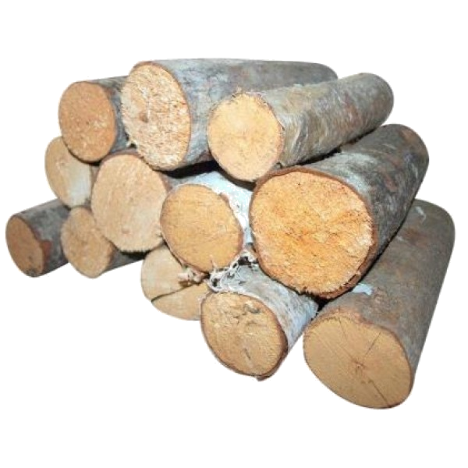
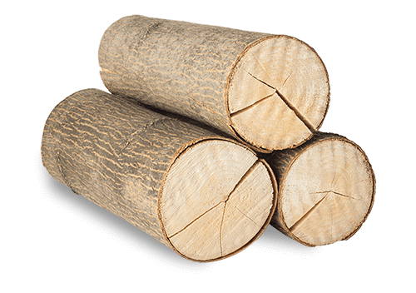
kayu
You are probably thinking that “kayu” , pronounced “car you”, means “your car” in Indonesian, right?
Unfortunately, you would be way off the mark!
The word “kayu” actually means “wood” in Indonesian.

Slide 4
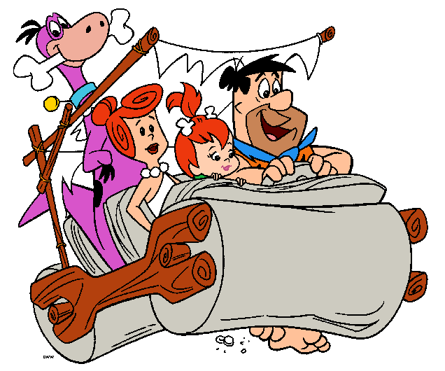
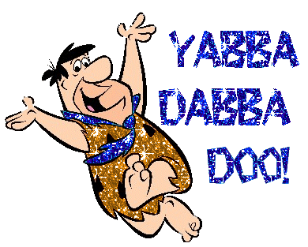
kayu
During the stone age, did you realise that cars were actually made out of “kayu” ?

