Slide 2
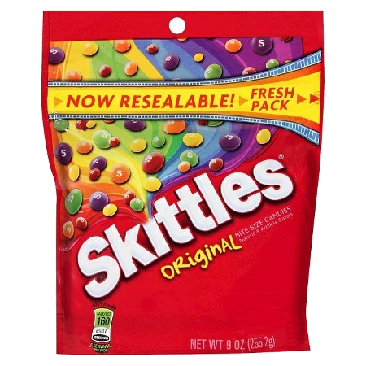
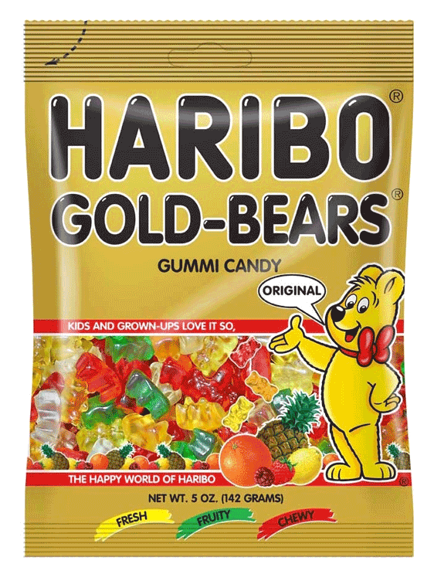
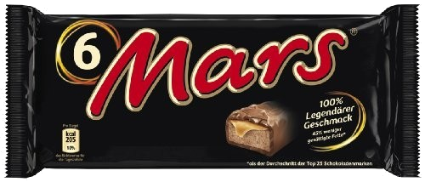
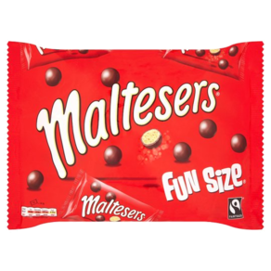
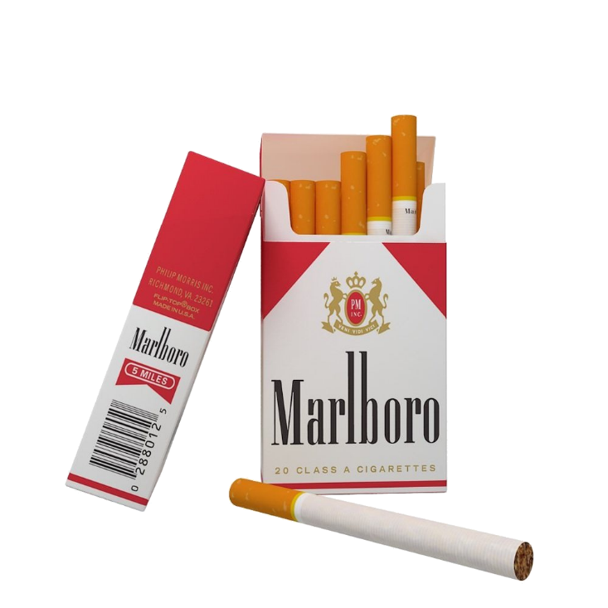
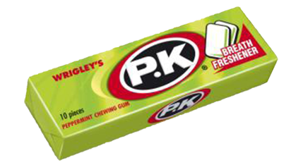
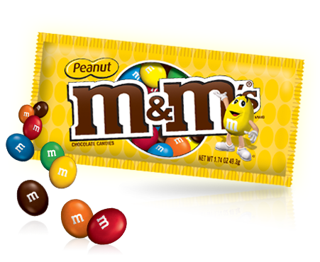
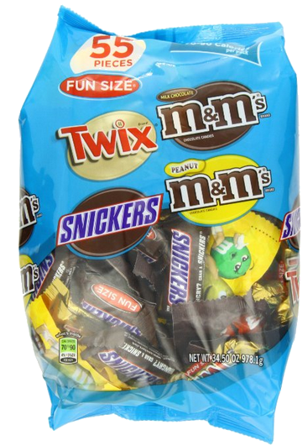
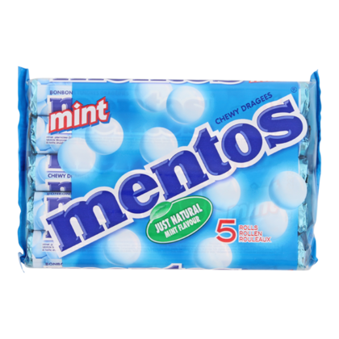
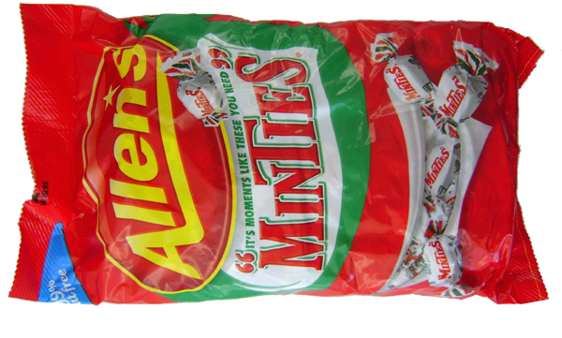
pak

Slide 3
pak
Selamat pagi, Bart. Your Indonesian is coming along well.
I gather you think that “pak”, pronounced “puck”, is the Indonesian word for a “pack” or “packet” of something.
Well, you can “pack” that thought away as I reveal that the honorific “Pak” means “Mr” or “Sir” in Indonesian.
“Pak” can also be used to address your father, much the same as “Dad” in English!
Selamat pagi, Pak.

Slide 4
pak
So, when you go to Indonesia, “pack” your dictionary and don’t confuse “pack” with “pak” because there’ll be a “pak” around every corner!
Nama saya Pak Skinner.
Nama saya Pak Burns.
Saya Pak Moe.
Hai, nama saya Pak Flanders.

