Slide 2
tangan

Slide 3
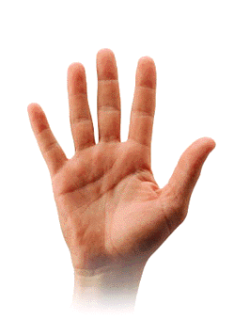
tangan
The word “tangan” (pronounced “tongue-un”) has nothing to do with the tongue!
In actual fact, “tangan” is the Indonesian word for “hand”.
You could say, that makes it a really handy word!

Slide 4
tangan
Let’s put our hands together or “tepuk tangan” for a round of applause.

