Slide 2
apokat

Slide 3
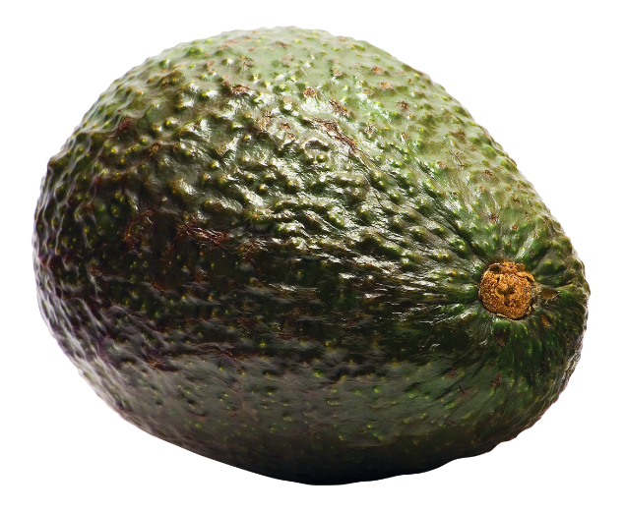
apokat
I know what you’re thinking … “apokat”, pronounced “a-po-kut”, must mean an “uppercut”, right? Sorry to disappoint you but you’ll need to find another “punchline”!
The noun “apokat” is an “avocado” in Indonesian.
Although I like the taste of avocado, I can’t really say that it has much of a “punch” to it!

