Slide 2
ayam

Slide 3
ayam
“ayam”, pronounced “I am”, is the Indonesian word for “chicken”.
If an Indonesian asks you if you are a “chicken”, you can simply reply, “Yes, ayam!”
“Help! Ayam in danger!!!”

Slide 4
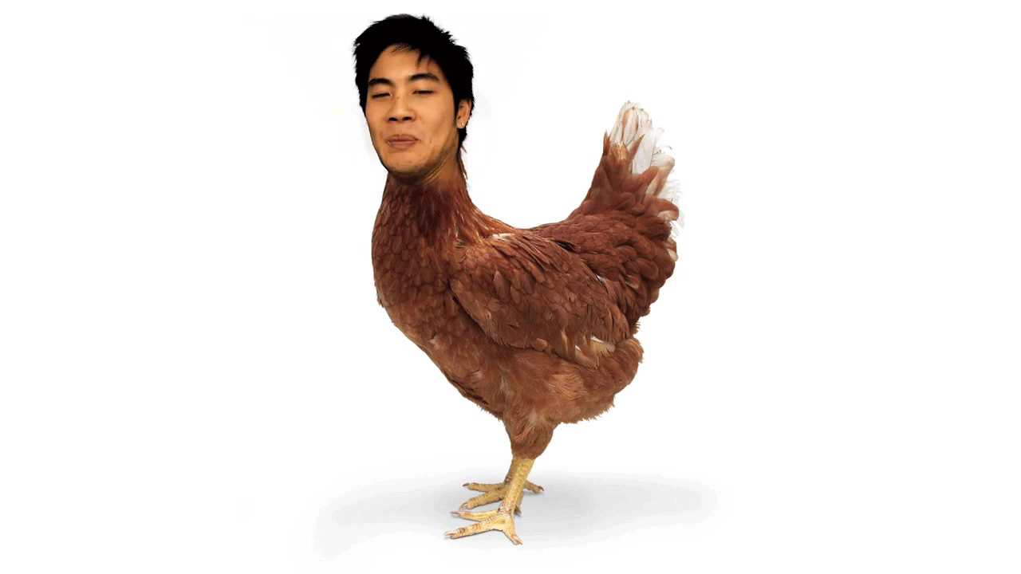
ayam
“Ayam a chicken, yes ayam! Ayam … Ayam … Ayam … Ayam !”

