Slide 2
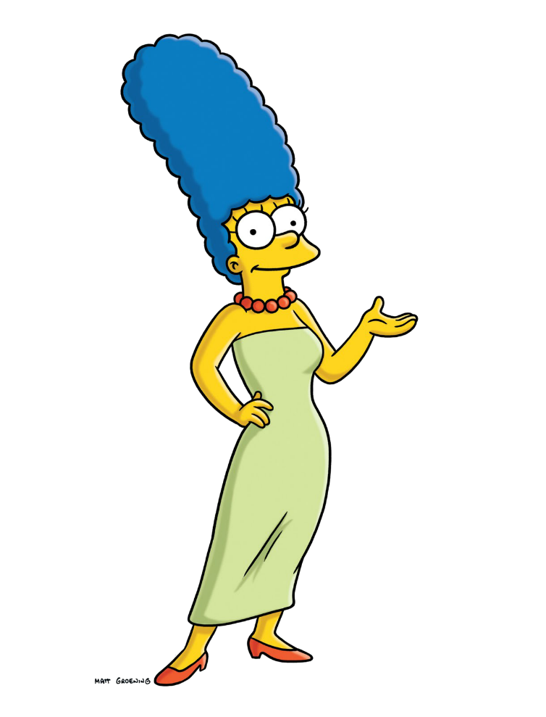
buaya
Bu
Ayah

Slide 3
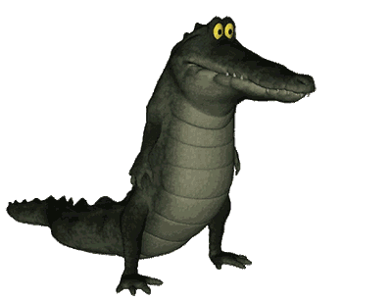
buaya
I know what you’re thinking! If “buaya” is a combination of “Bu” (Mum) and “Ayah” (Dad), then it must mean “parents”. Right?
Nothing could be further from the truth! In bahasa Indonesia, “buaya” actually means “crocodile”.

Slide 4
buaya
I’ll bet Homer harbours thoughts of throwing Bart to the crocodiles!

