Slide 2
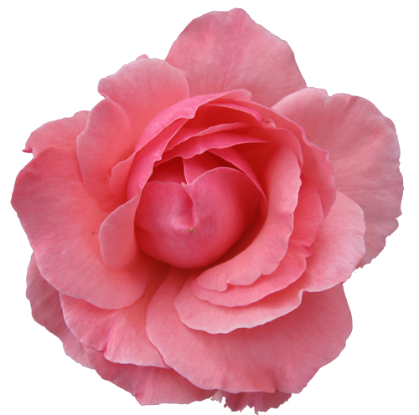
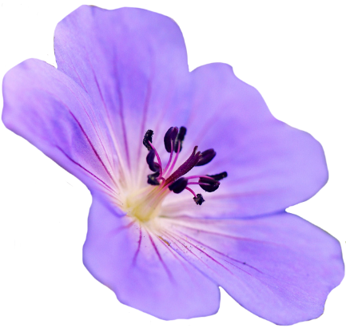
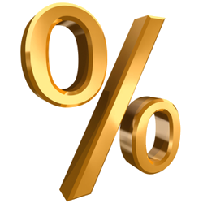
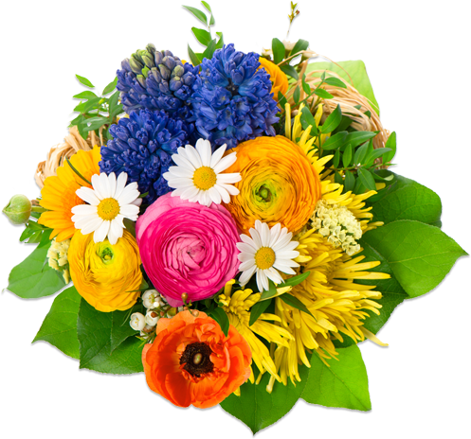
bunga

Slide 3
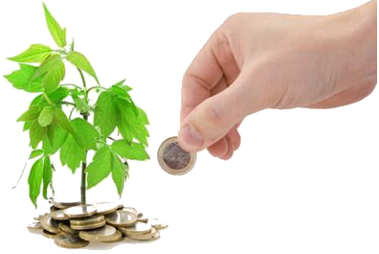
bunga
Confused? Can’t say I blame you! What do flowers have to do with percentages and interest rates?
In Indonesian, the word “bunga”, pronounced “boong-ah”, means both “flower” and “interest” received on bank deposits and savings.
Think of it this way … as you save your money, it flowers and grows.

Slide 4
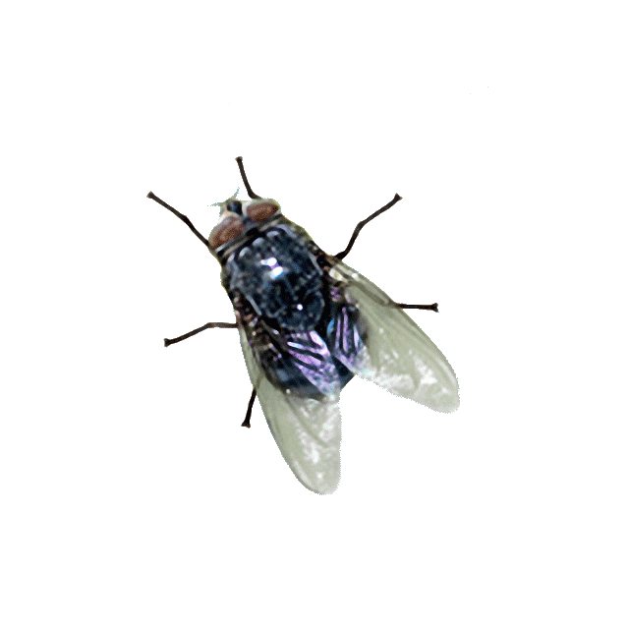
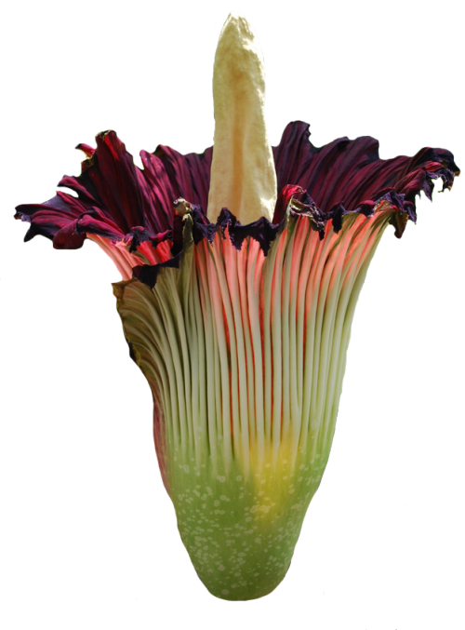
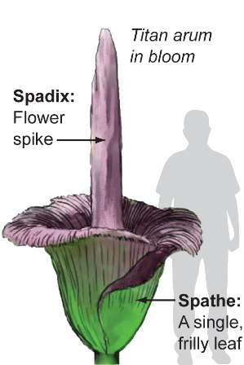
bunga
Did you know that both the tallest and largest “bunga” in the world are native to Indonesia?
The “Amorphophallus Titanum” is the tallest flower and can grow up to 10 feet in height. That’s some “bunga” !!!

Slide 5
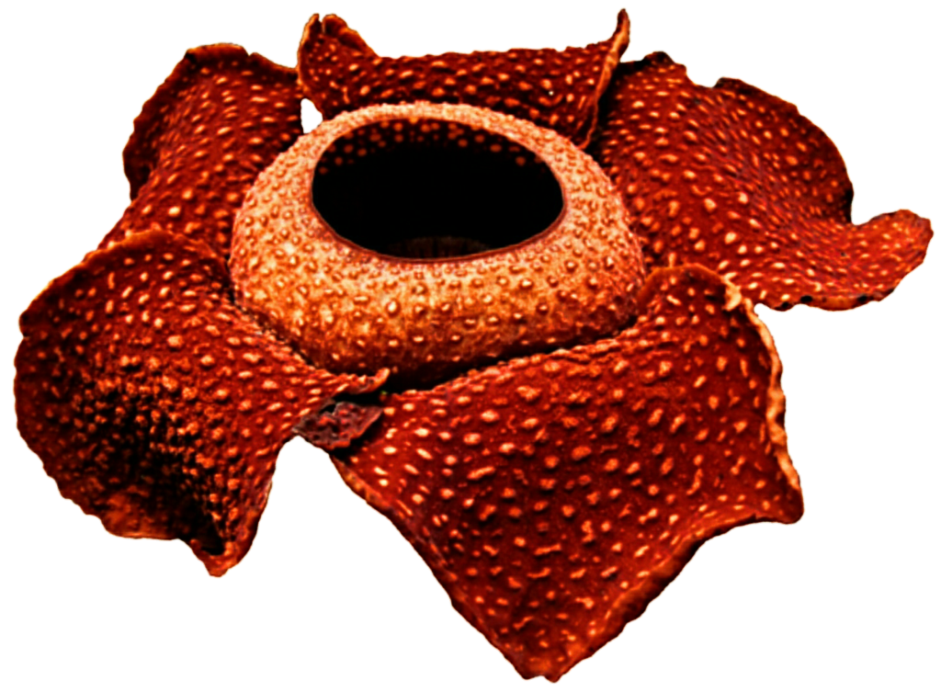
bunga
The largest blooming flower in the world is the “Rafflesia Arnoldii” which can grow up to a metre across and weigh up to 7 kilograms! It is a parasitic plant, with no visible leaves, roots, or stem.
Both the “Amorphophallus Titanum” and “Rafflesia Arnoldii” are known as the “corpse flower” because they both emanate the smell of a decaying corpse which attracts the insects on which both species feed.

