Slide 1
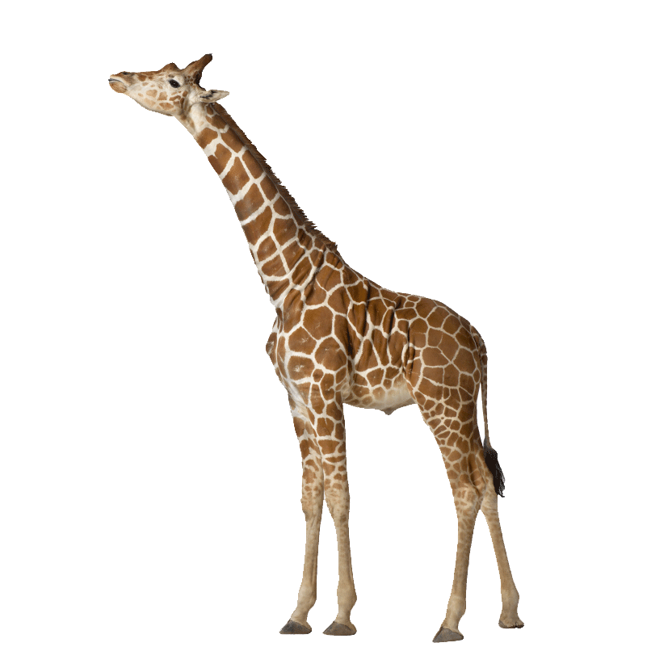
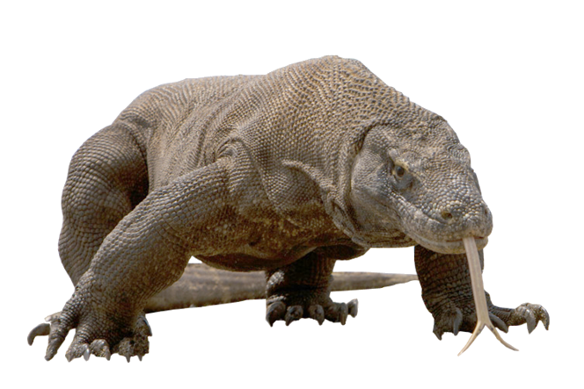
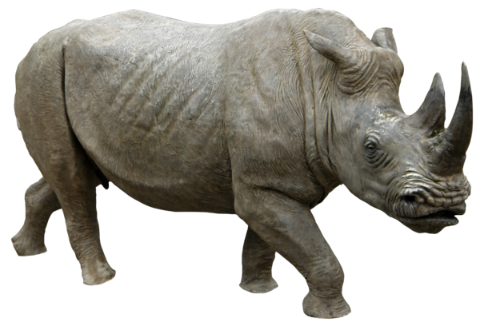
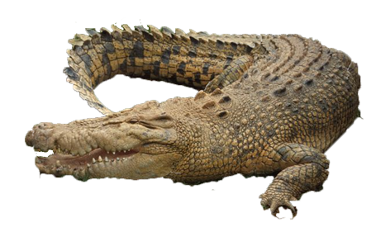
Describing Animals
There’s No Monkey Business Here!

Slide 2
The “se~” Prefix
The “se~” prefix can come in very handy when describing animals.
Let’s look at the prefix “se~” + the noun “ekor” .
The article “seekor” means “a” or “an” when placed before the name of an animal
For example, “Seekor orangutan” (An orang-utan).

Slide 3
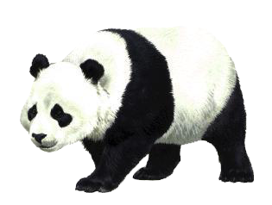
See if you can identify this animal …
Ini binatang apa?

Slide 4
Ini seekor panda.

Slide 5
See if you can identify this animal …
Ini binatang apa?

Slide 6
Ini seekor komodo.

Slide 7
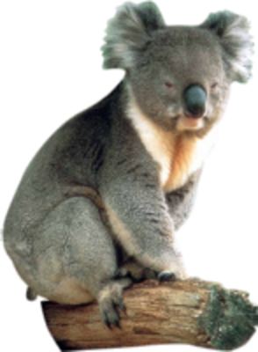
See if you can identify this animal …
Ini binatang apa?

Slide 8
Ini seekor koala.

Slide 9
The “ber~” Prefix
The “ber~” prefix can come in very handy when describing animals.
Let’s look at the prefix “ber~” + the verb “asal” .
The verb “berasal” means “to originate from …”
For example, “Seekor orangutan berasal dari Indonesia” (An orang-utan comes from Indonesia).

Slide 10
See if you can say where this animal originates from …
Seekor panda berasal dari mana?

Slide 11
Seekor panda berasal dari Cina.

Slide 12
See if you can say where this animal originates from …
Seekor komodo berasal dari mana?

Slide 13
Seekor komodo berasal dari Indonesia.

Slide 14
See if you can say where this animal originates from …
Seekor koala berasal dari mana?

Slide 15
Seekor koala berasal dari Australia.

Slide 16
The “ber~” Prefix
The “ber~” prefix can come in very handy when describing an animal’s body parts or distinctive features.
Let’s look at the prefix “ber~” + a body part + one or more adjectives .
The verb “ber + Body Part + Adjective ” means “to have a (Body Part) which is (Adjective)”
For example, “Seekor orangutan berlengan panjang dan kuat (An orang-utan has arms which are long and powerful).

Slide 17
See if you can describe this animal’s fur (bulu) …
Bagaimana seekor panda?

Slide 18
Seekor panda berbulu tebal, hitam dan putih.
A panda has fur which is thick, black and white.

Slide 19
See if you can describe this animal’s tail (ekor) …
Bagaimana seekor komodo?

Slide 20
Seekor komodo berekor panjang dan kuat.
A komodo has a tail that is long and powerful.

Slide 21
See if you can describe this animal’s ears (telinga) …
Bagaimana seekor koala?

Slide 22
Seekor koala bertelinga besar dan berbulu.
A koala has ears which are large and furry.

Slide 23
The “~nya” Suffix
The “~nya” suffix can also come in very handy when describing an animal’s body parts or distinctive features.
Let’s look at the structure Body Part + “~nya” + one or more adjectives .
The structure Body Part + “~nya” + Adjective ” means “its (Body Part) is (Adjective)”
For example, “Bulunya coklat kemerahan (Its fur is reddish brown).

Slide 24
See if you can describe this animal’s ears (telinga) …
Bagaimana telinga seekor panda?

Slide 25
Telinganya kecil dan berbulu hitam.
Its ears are small and black-furred.

Slide 26
See if you can describe this animal’s skin (kulit)
Bagaimana kulit seekor komodo?

Slide 27
Kulitnya tebal dan keras.
Its skin is thick and hard.

Slide 28
See if you can describe this animal’s nose (hidung) …
Bagaimana hidung seekor koala?

Slide 29
Hidungnya hitam dan pesek.
Its nose is black and flat.

Slide 30
Describing the Personality of Animals
The personality of an animal can be expressed using the structure:
Seekor ANIMAL ADJECTIVE dan ADJECTIVE.
A/An ANIMAL is ADJECTIVE and ADJECTIVE.

Slide 31
Seekor panda malu dan jinak.
A panda is shy and docile.

Slide 32
Seekor komodo ganas dan berbahaya.
A komodo is fierce and dangerous.

Slide 33
Seekor koala mungil dan jinak.
A koala is cute and docile.

Slide 34
Comparing Attributes of the Animal to a Similar Species
The attributes of an animal can be compared to a similar species using one of the following structures:
Seekor ANIMAL lebih ADJECTIVE daripada seekor ANIMAL.
A/An ANIMAL is more ADJECTIVE than a/an ANIMAL.
or
Seekor ANIMAL adalah SPECIES yang paling ADJECTIVE.
A/An ANIMAL is the SPECIES which is most ADJECTIVE.

Slide 35
Seekor panda lebih kecil daripada seekor beruang kutub.
A panda is smaller than a polar bear.

Slide 36
Seekor komodo lebih besar dan ganas daripada seekor goanna Australia.
A komodo is bigger and more fierce than an Australian goanna.

Slide 37
Seekor koala lebih kecil daripada seekor panda.
A koala is smaller than a panda.

Slide 38
Discussing the Weight Range of Animals
The weight range of an animal can be expressed using the structure:
Berat badan seekor ANIMAL bisa mencapai NUMBER kilogram sampai NUMBER kilogram.
The body weight of a/an ANIMAL can reach NUMBER kilograms up to NUMBER kilograms.

Slide 39
Berat badan seekor panda bisa mencapai 100 kilogram sampai 115 kilogram.

Slide 40
Berat badan seekor komodo bisa mencapai 68 kilogram sampai 91 kilogram.

Slide 41
Berat badan seekor koala bisa mencapai 4 kilogram sampai 15 kilogram.

Slide 42
Discussing the Life Span of Animals
The life span of an animal can be expressed using the structure:
Jangka hidup seekor ANIMAL bisa mencapai NUMBER tahun sampai NUMBER tahun.
The life span of a/an ANIMAL can reach NUMBER years up to NUMBER years.

Slide 43
Jangka hidup seekor panda bisa mencapai 15 tahun sampai 20 tahun.

Slide 44
Jangka hidup seekor komodo bisa mencapai 30 tahun.

Slide 45
Jangka hidup seekor koala bisa mencapai 13 tahun sampai 18 tahun.

Slide 46
Discussing the Diet of Animals
The diet of an animal can be expressed using the structure:
Seekor ANIMAL suka makan FOOD TYPE seperti EXAMPLE.
A/An ANIMAL likes to eat FOOD TYPE such as EXAMPLE.

Slide 47
Examples of Food Types
buah-buahan fruit
tumbuh-tumbuhan plants
daun-daun leaves
serangga insects
ikan fish
daging binatang lain the flesh of other animals

Slide 48
Seekor panda suka makan bambu.

Slide 49
Seekor komodo suka makan daging binatang lain seperti kerbau, rusa dan babi.

Slide 50
Seekor koala suka makan daun-daun dari pohon eukaliptus.

Slide 51
Discussing the Habitat of Animals
The habitat of an animal can be expressed using the structure:
Seekor ANIMAL hidup di HABITAT di SPECIFIC LOCATION.
A/An ANIMAL lives in HABITAT in SPECIFIC LOCATION.

Slide 52
Seekor panda di hutan bambu di pegunungan Cina Tengah.

Slide 53
Seekor komodo tinggal di Pulau Komodo, Rinca dan Gili Montang di Indonesia.

Slide 54
Seekor koala hidup di hutan pohon eukaliptus di pantai timur Australia.

Slide 55
Discussing the Status of Animals
The status or level of endangerment of an animal can be expressed using the structure:
Status seekor ANIMAL CURRENT STATUS.
The status of a/an ANIMAL is CURRENT STATUS .

Slide 56
Levels of Endangerment of Animals
terancam punah threatened with extinction
terancam kritis critically endangered
dalam bahaya endangered
terancam rawan vulnerable
sekarang dilindungi now protected

Slide 57
Status seekor panda sekarang dilindungi.

Slide 58
Status seekor komodo terancam rawan.

Slide 59
Status seekor koala terancam kritis.

Slide 60
Seekor Badak Jawa
Ini seekor badak Jawa. Seekor badak Jawa berasal dari pulau Jawa di Indonesia. Seekor badak Jawa berbadan yang besar dan tebal. Culanya panjang dan tajam. Berat badan seekor badak Jawa 900 kilogram sampai 2300 kilogram. Jangka hidup seekor badak Jawa 30 tahun sampai 45 tahun. Seekor badak Jawa suka makan tumbuh-tumbuhan dan buah-buahan.

Slide 61
Seekor Badak Jawa
Seekor badak Jawa hidup di hutan rimba di pulau Jawa. Status badak Jawa terancam kritis

