Slide 2
duit

Slide 3
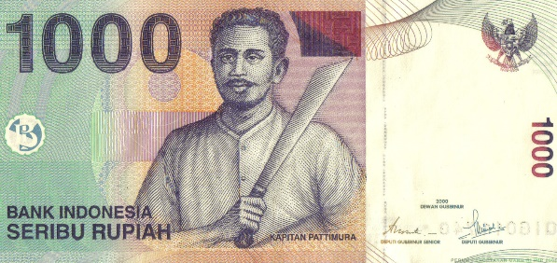
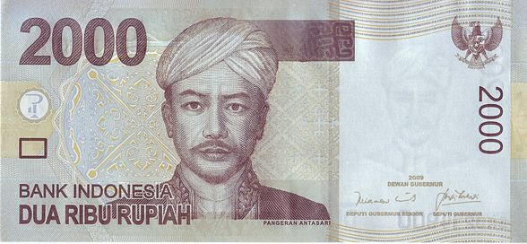
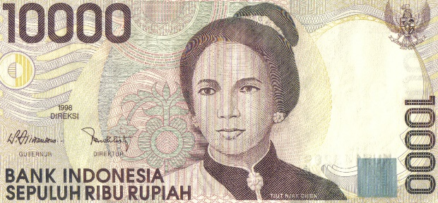
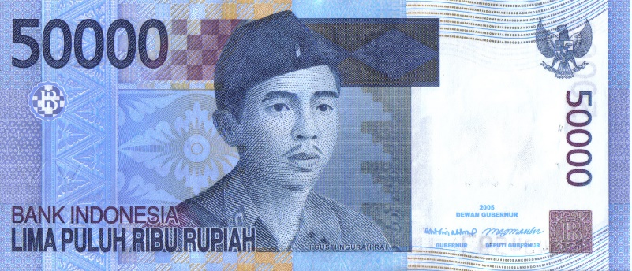
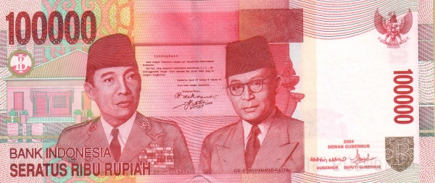
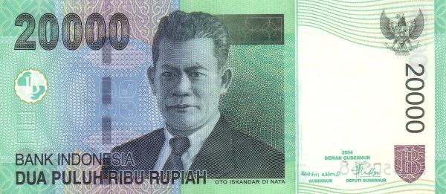
duit
“duit” , pronounced “do it”, has nothing to do with the marketing of NIKE products in Indonesia! It is, in fact, the informal Indonesian word for “money”!

Slide 4
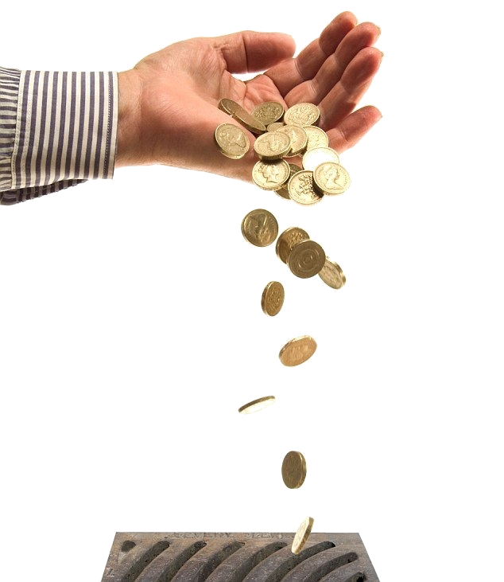
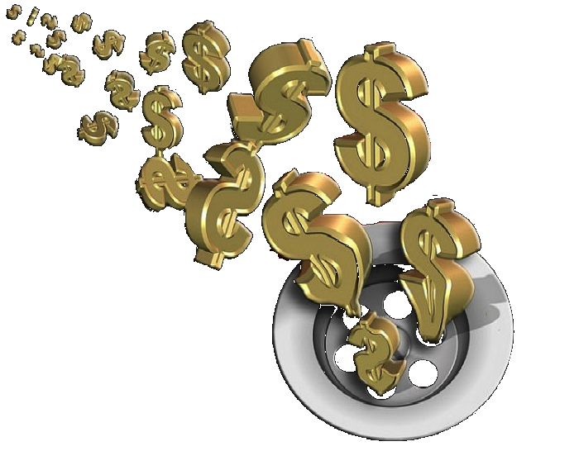
duit
If an Indonesian wishes to borrow money, he will say, “Pinjam duit, dong” (“Lend me some money, mate”).
My advice to you is, don’t “duit” because you’ll never see your money again !!!

