Slide 2
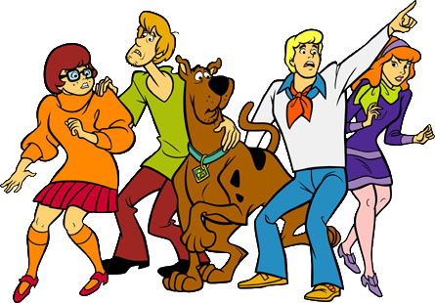
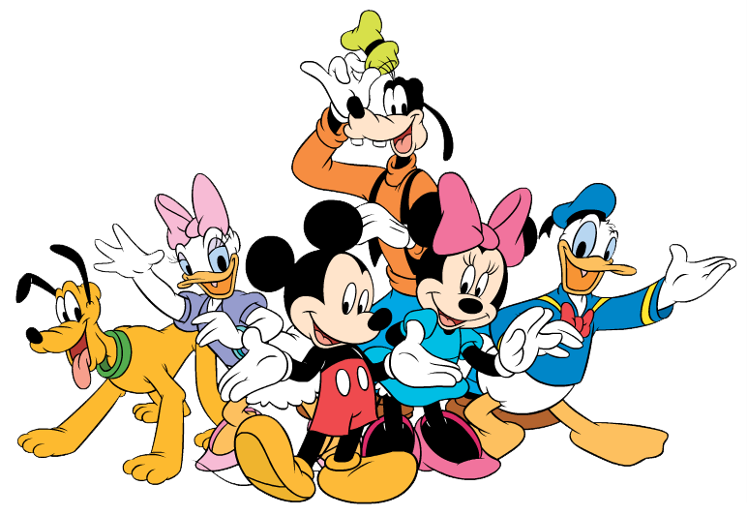
gang

Slide 3
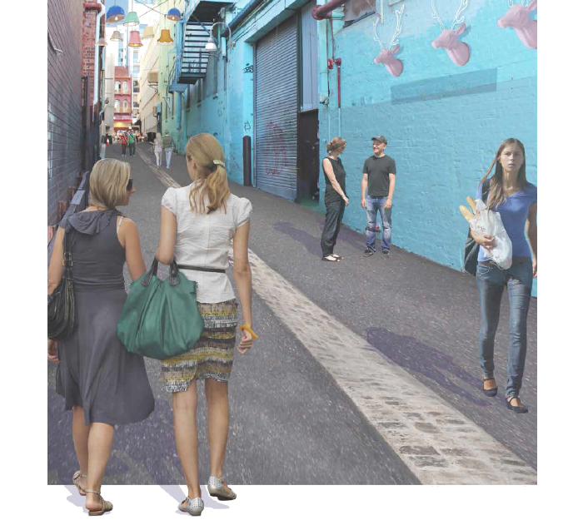
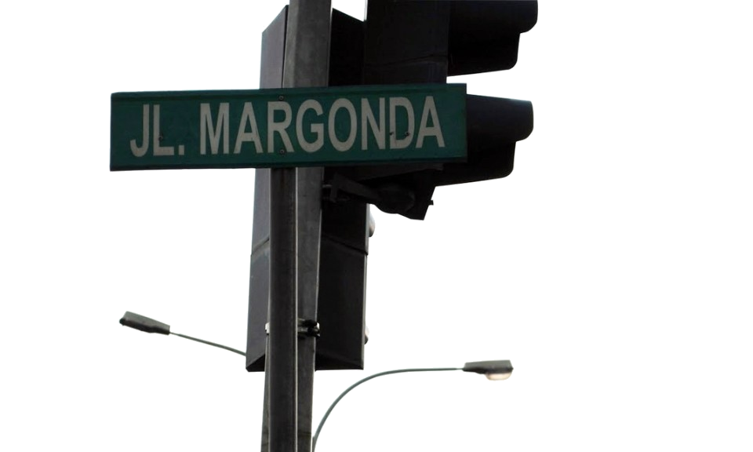
gang
You are probably thinking that “gang”, pronounced “gung”, means “gang” in Indonesian, right? Well, “gang”, I’m sorry to disappoint you, but it doesn’t!
Allow me to set you on the straight and narrow path. In Indonesian, a “gang” is a “laneway” or “alley”, which is usually only wide enough for motorcycle traffic.

Slide 4
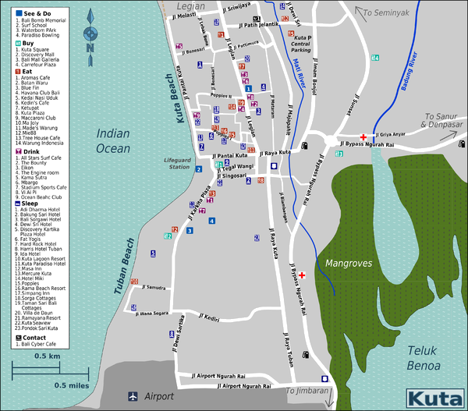
gang
Indonesians name all their streets “Jalan” (plus name) and all their lanes “Gang” (plus name). For example, “Jalan Sudirman”. The word “Jalan” is abbreviated “Jl.” and “Gang” is abbreviated “Gg”. If you look at this map of Kuta in Bali, the streets are all labelled but the narrow lanes are not.
If you want to be in a “gang”, just go to the capital, Jakarta … you’ll find millions of them there!

