Slide 2
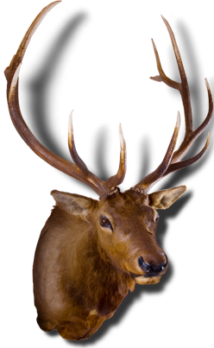
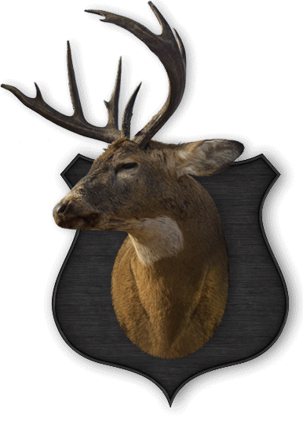
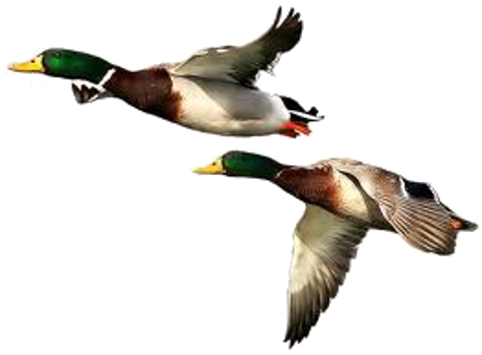
hantu

Slide 3
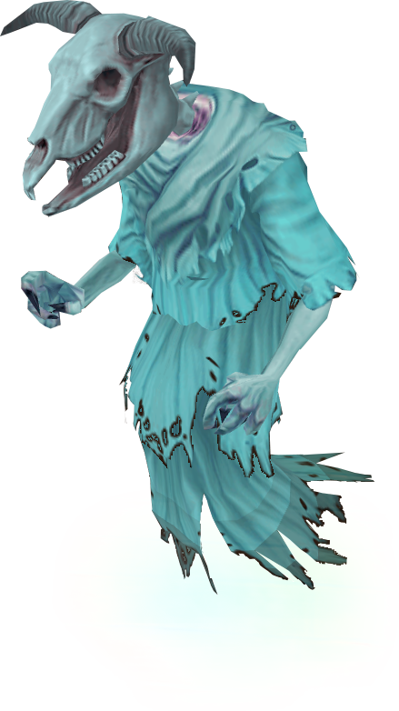
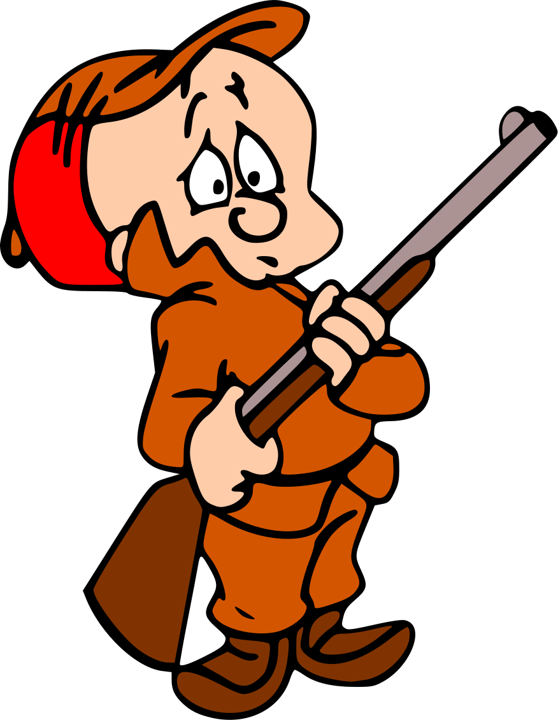
hantu
You are probably thinking that “hantu”, pronounced “hun-too”, means “to hunt” in Indonesian, right? Even though you’ve “given it your best shot”, you are “still barking up the wrong tree.”
The Indonesian noun “hantu” means “ghost”.
I hope all hunters are haunted by the “hantu” of the wildlife they kill in the name of sport.

Slide 4
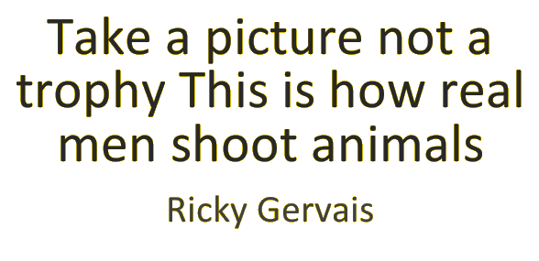
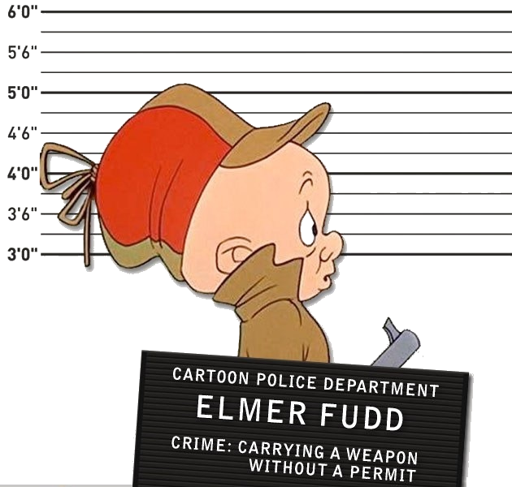
hantu
In a civilised world, there is no room for the senseless slaughter of any species.

