Slide 1
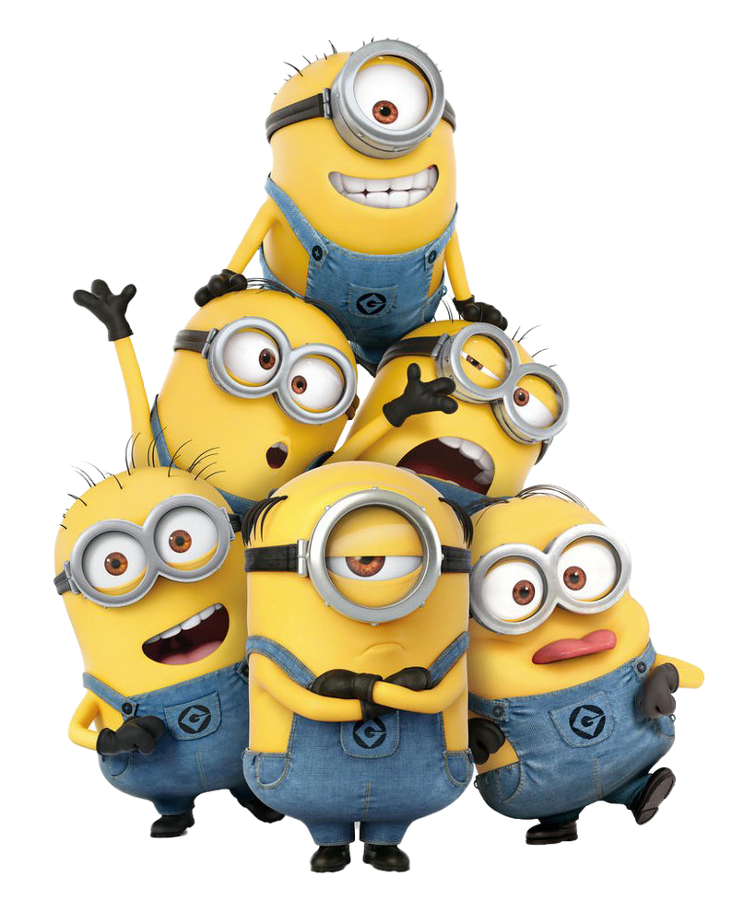
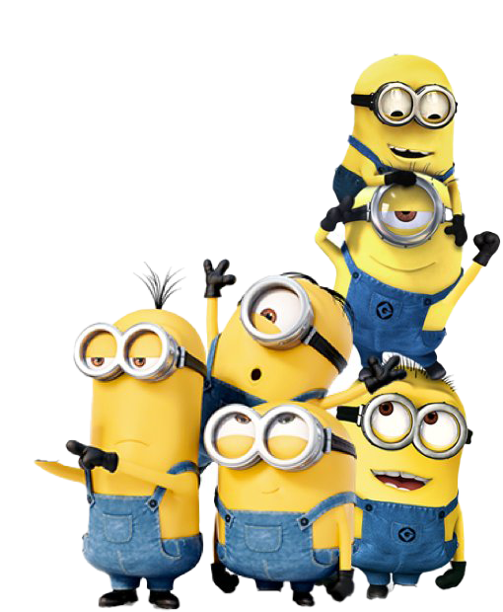
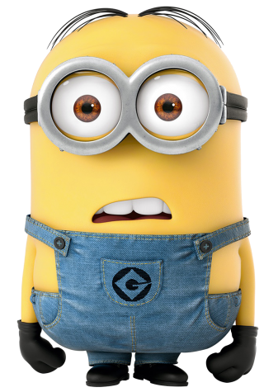
Inilah AlasanMengapa Minions Berbicara Bahasa Indonesia
https://www.goodnewsfromindonesia.id/infographic/inilah-alasan-mengapa-minions-berbicara-bahasa-indonesia?fbclid=IwAR1EWcxzt-b0rTcNEG7j3uR2R5Nrqy2vroEygTuXCbBzGTBwx3h51mCNkO8

Slide 3
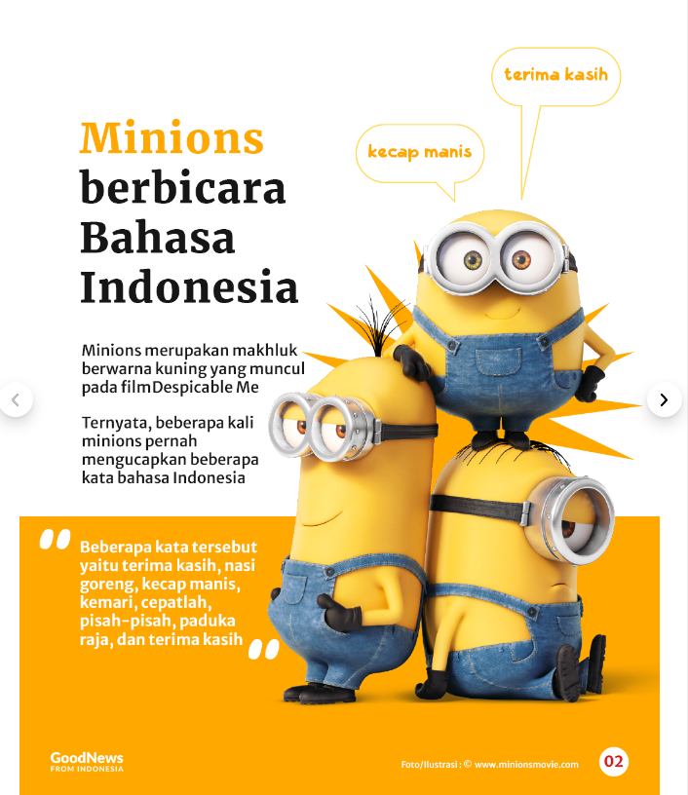

Slide 4
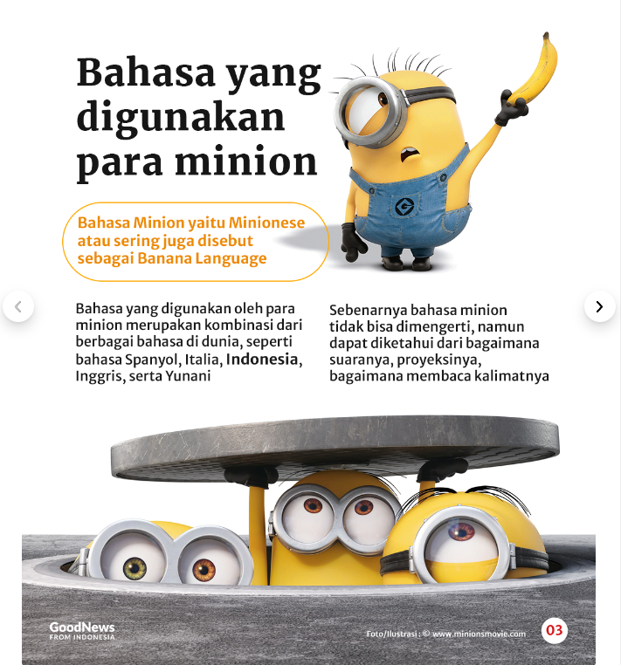

Slide 5
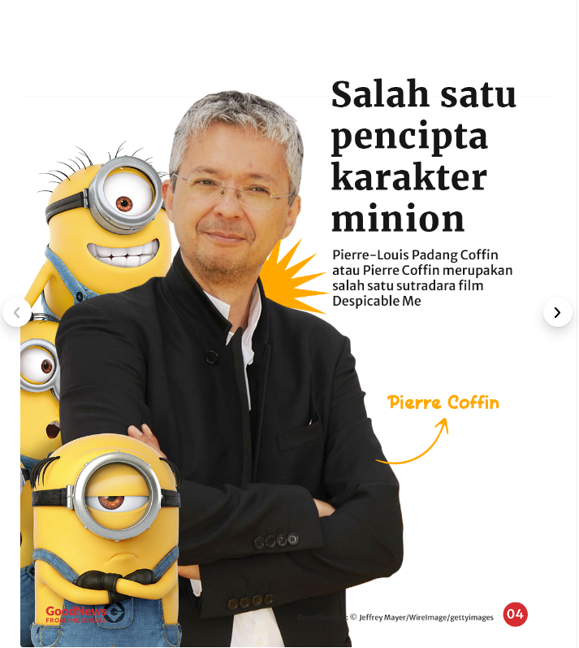

Slide 6
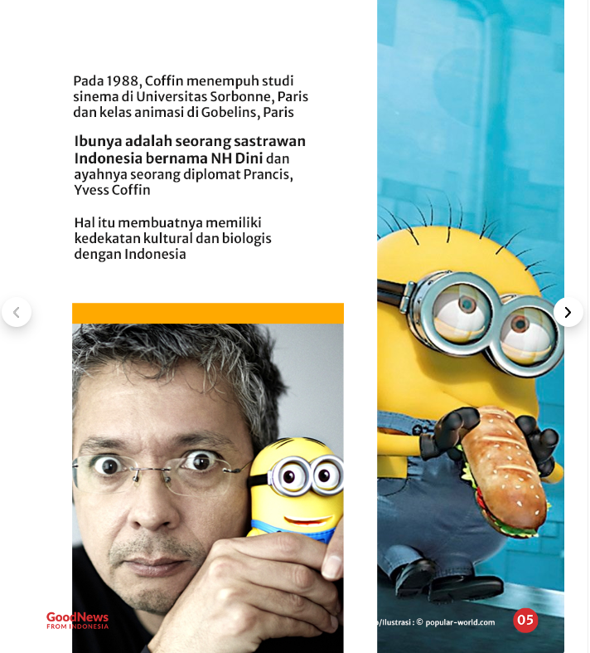

Slide 7
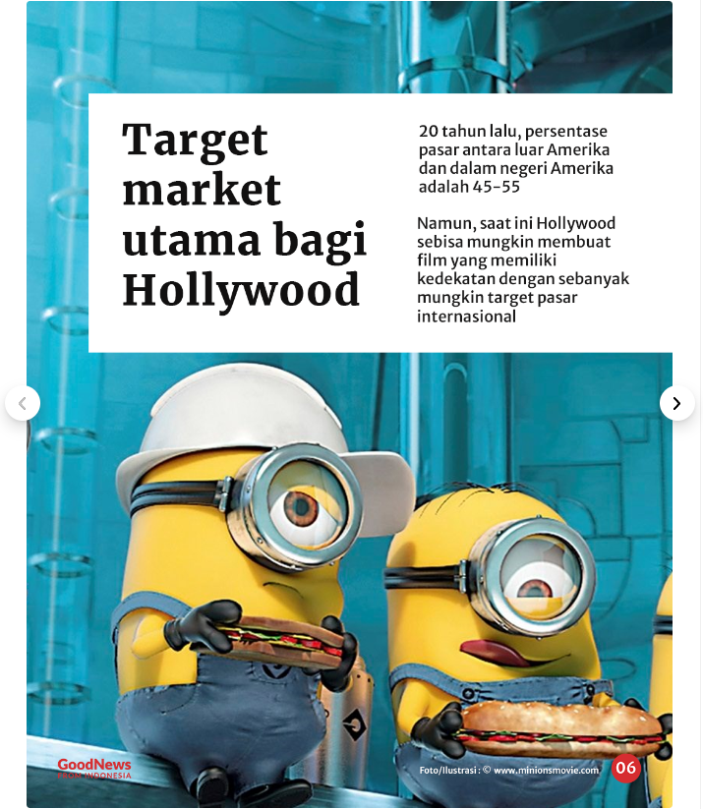

Slide 8
