Slide 2
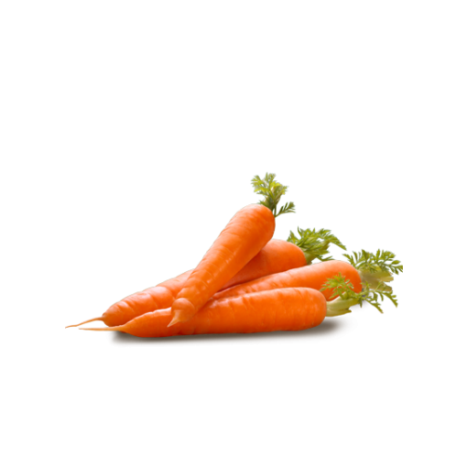
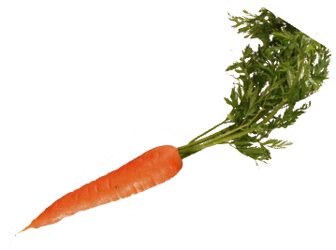
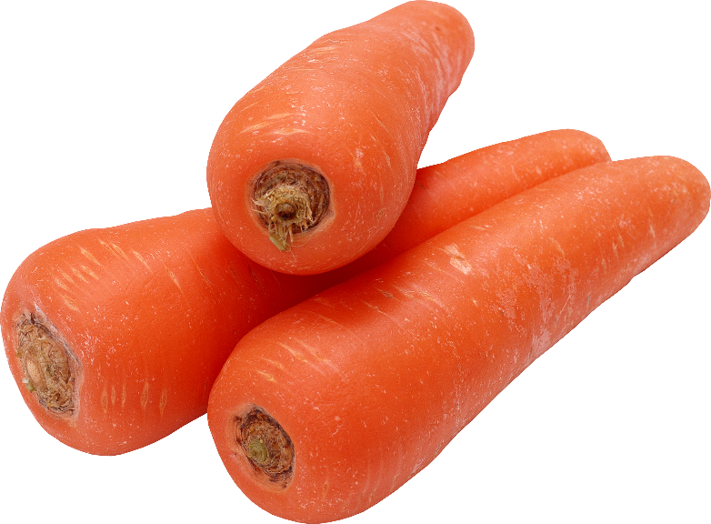
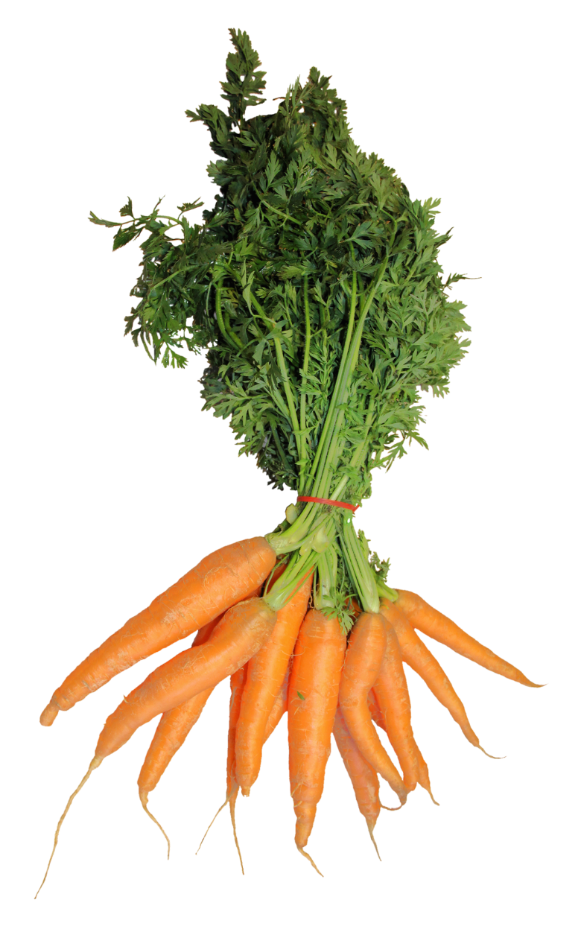
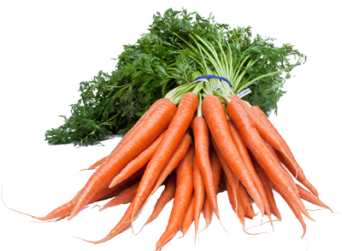
karat

Slide 3
karat
You must be thinking that “karat”, pronounced “car-rut”, is the Indonesian word for “carrot”, right?
You’re getting a little “rusty” because the noun “karat” means both “rust” and a “measure of purity” for gold and diamonds.

Slide 4
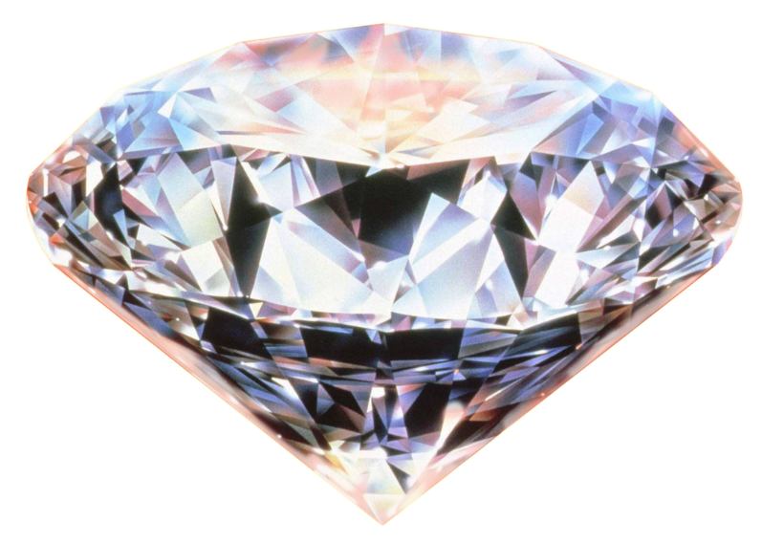
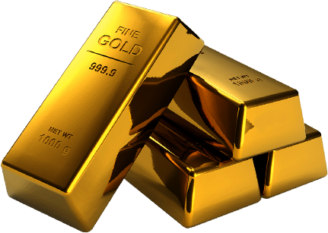
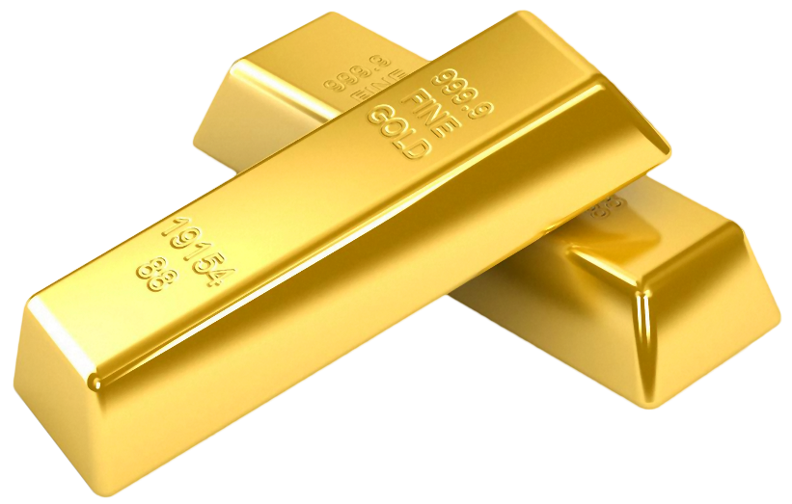
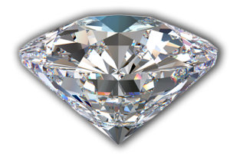
karat
When shopping for gold or diamond jewellery in Indonesia, be extra careful to ensure they are both free from “karat” and have a high “karat” value

