Slide 1
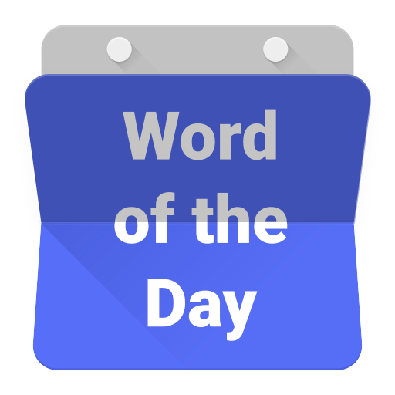

Slide 2
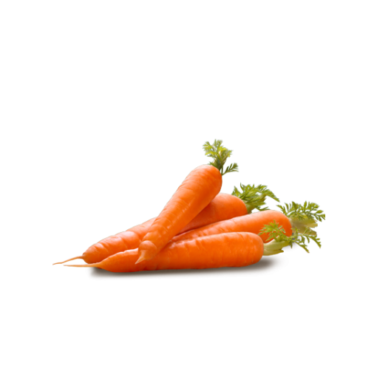
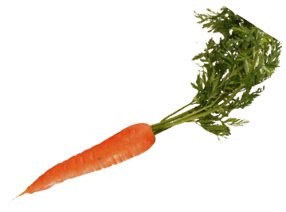
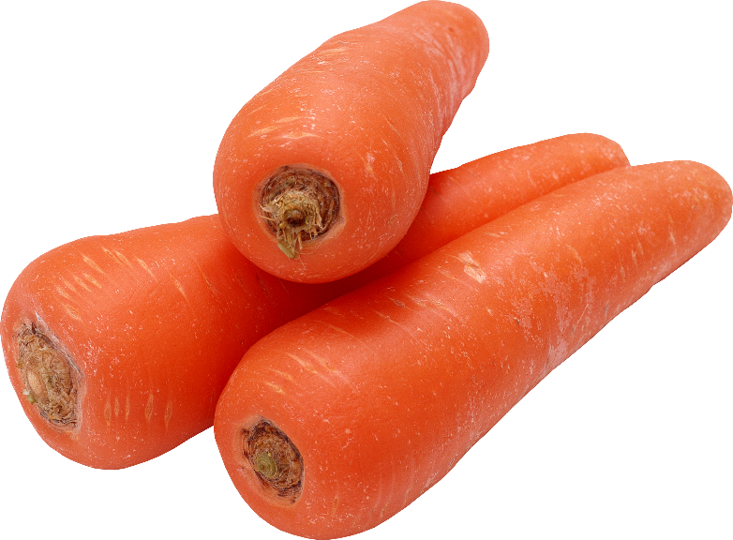
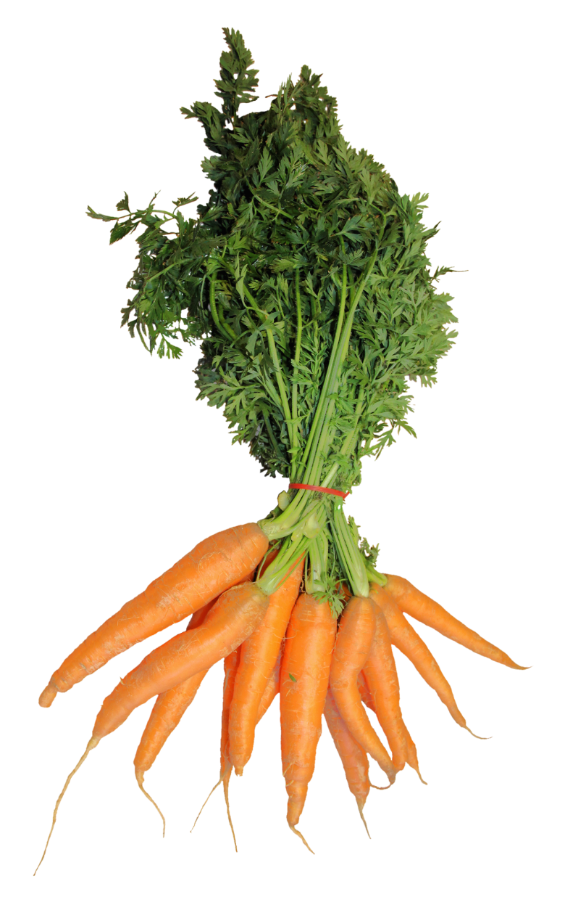
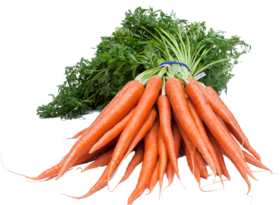
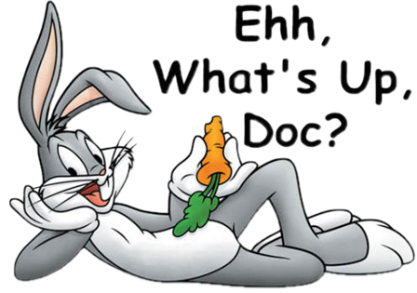
karet

Slide 3
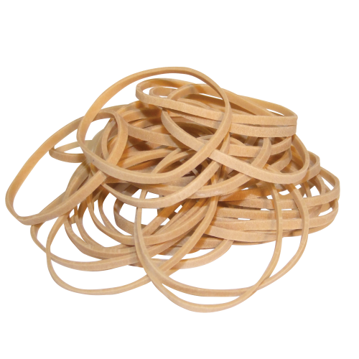
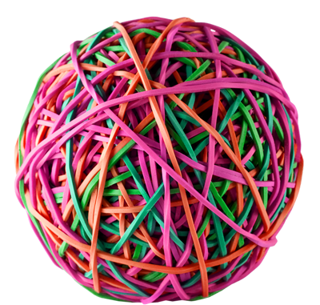
karet
You must be thinking that “karet”, pronounced “car-ret”, is the Indonesian word for “carrot”, right?
Your logic is a little “rubbery” because the noun “karet” actually means “rubber” in Indonesian.

Slide 4
karet
Indonesians are notorious for following “jam karet” or “rubber (elastic) time”. So, if an Indonesian is late for an appointment or event, you just need to grin and bear it!

