Slide 2
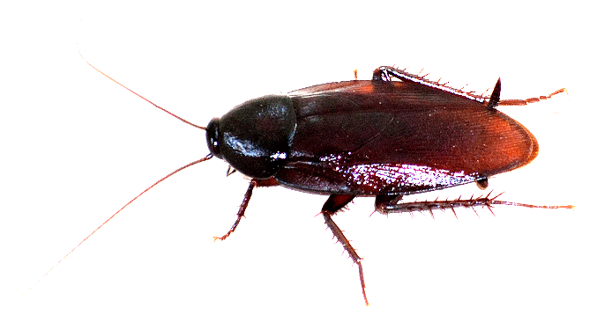
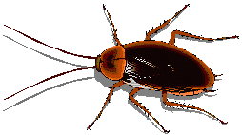
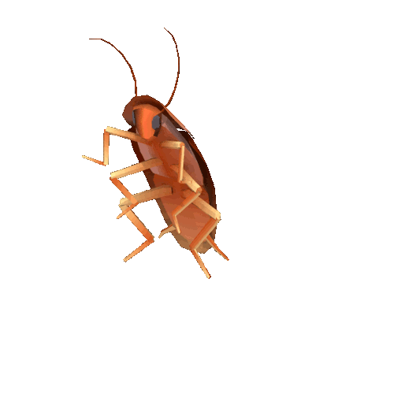
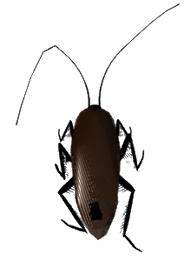
kecoa & coro

Slide 3
kecoa & coro
As you have probably guessed, “kecoa” (keh-cho-ah) and “coro” (chore-roh) both mean “cockroach”.
“coro” is actually the Javanese word for “cockroach” but, due to the Javanese being the dominant ethnic group, it is used throughout Indonesia.
As cockroaches are known to survive nuclear explosions, Indonesians take their cockroach problem very seriously.

Slide 4
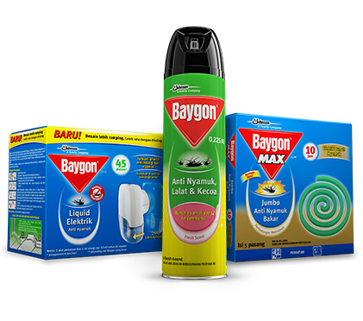
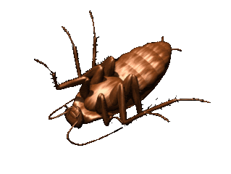
kecoa & coro
The most popular commercial insect killer in Indonesia by far is the Baygon range of products.

Slide 5
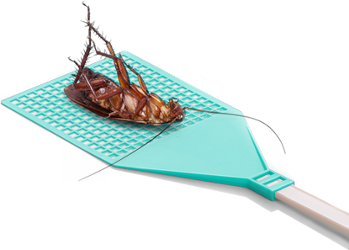
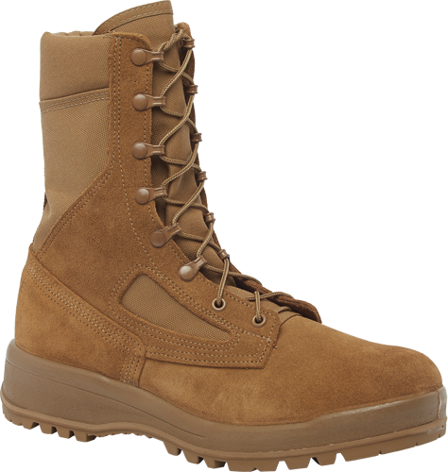
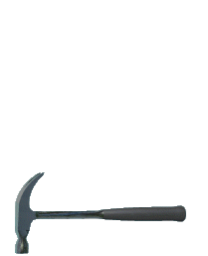
kecoa & coro
However, as these products are rather expensive, many Indonesians rely on more traditional methods to rid themselves of these pests.

