Slide 2
kikir

Slide 3
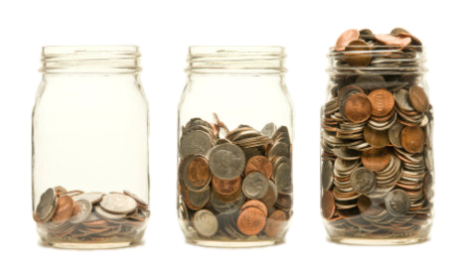
kikir
You probably think the word “kikir”, pronounced “kick-ear”, is the Indonesian word for “a kick to the ear”, right? Lend me an “ear” while I set the record straight.
The adjective “kikir” means to be “parsimonious”, “thrifty”, “stingy”, “frugal”, “miserly” or “tight-fisted” with your money!

Slide 4
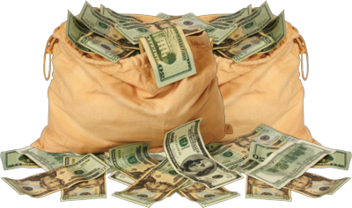
kikir
I don’t know about you, but I’d rather be a “kikir” than take a “kick to the ear” anytime!

