Slide 2
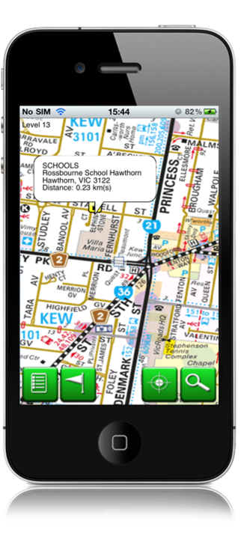
map

Slide 3
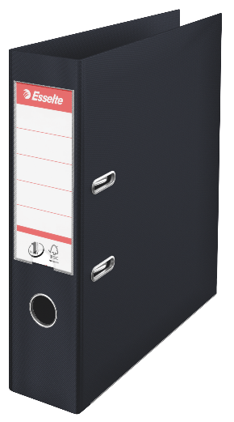
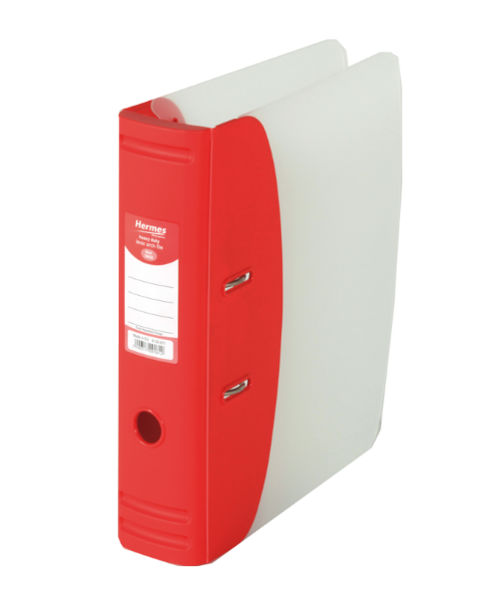
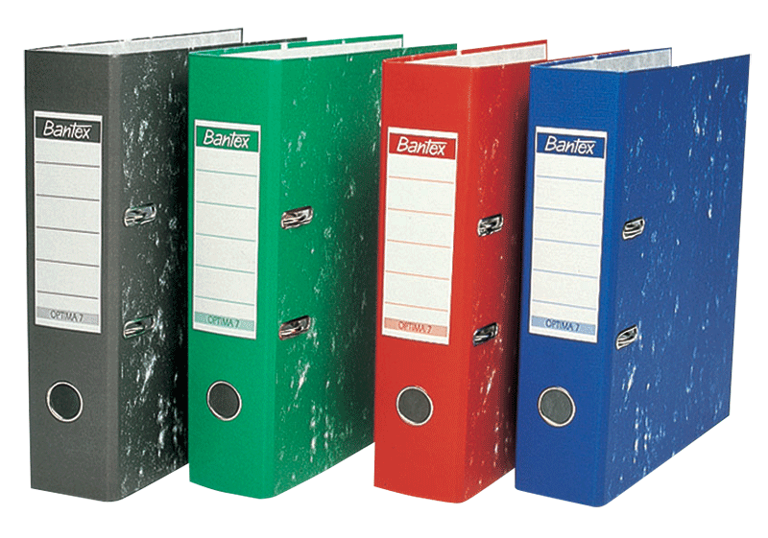
map
You are probably thinking that “map”, pronounced “mup”, is the Indonesian word for “map”, right?
You are going the wrong way up a one-way street if you believe that!
The noun “map” actually means “folder” in Indonesian.

Slide 4
map
If you do well in your study of Indonesian and keep your notes organised in a “map”, you could “map” out a successful future in an ever-increasing range of careers as long as you stay on track?

