Slide 2
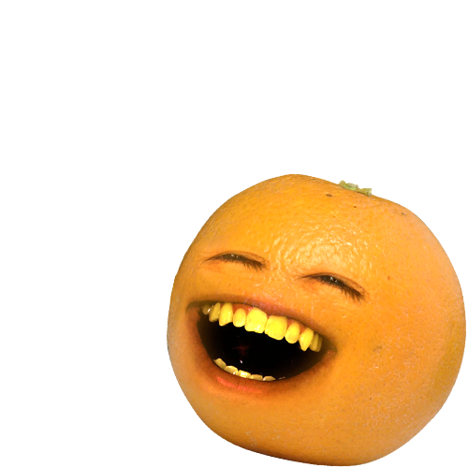
menjengkelkan

Slide 3
menjengkelkan
You’ve probably guessed from the image that “menjengkelkan” means “annoying”!
If you have difficulty saying this word, try breaking it up into syllables “men-jeng-kel-kan”
That wasn’t too difficult, was it? Now go away and annoy somebody else!!!

