Slide 2
pepaya

Slide 3
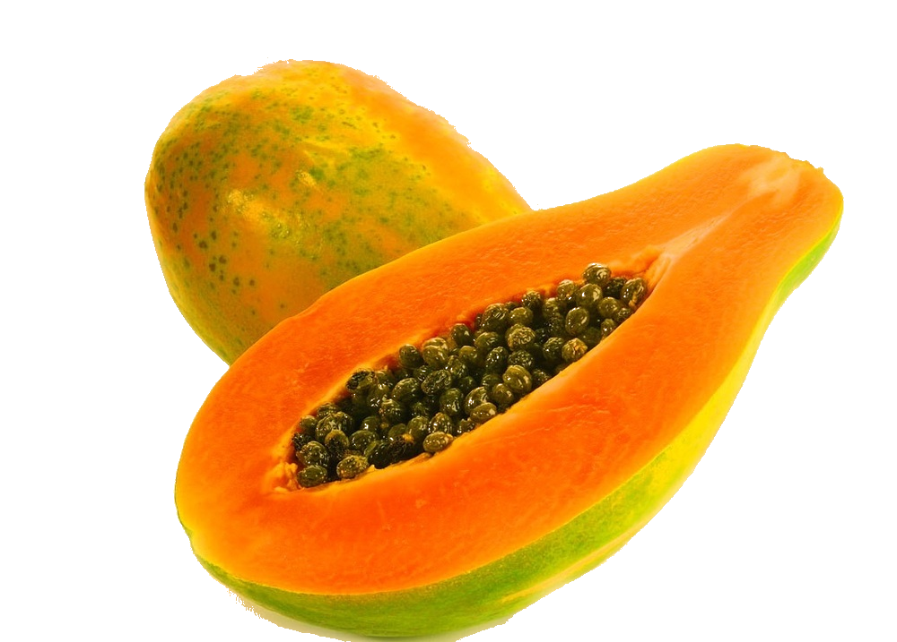
pepaya
No, “pepaya” is not the Indonesian name of “Popeye”. If it was, it would be spelt with a capital letter!
“pepaya” is the Indonesian word for the tropical fruit “paw-paw”.
As it is relatively inexpensive, you won’t go “poor” by eating “paw-paw”. In fact, it is rich in antioxidants and helps prevent many cancers!

Slide 4
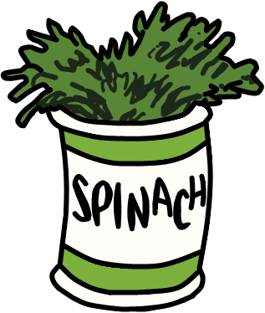
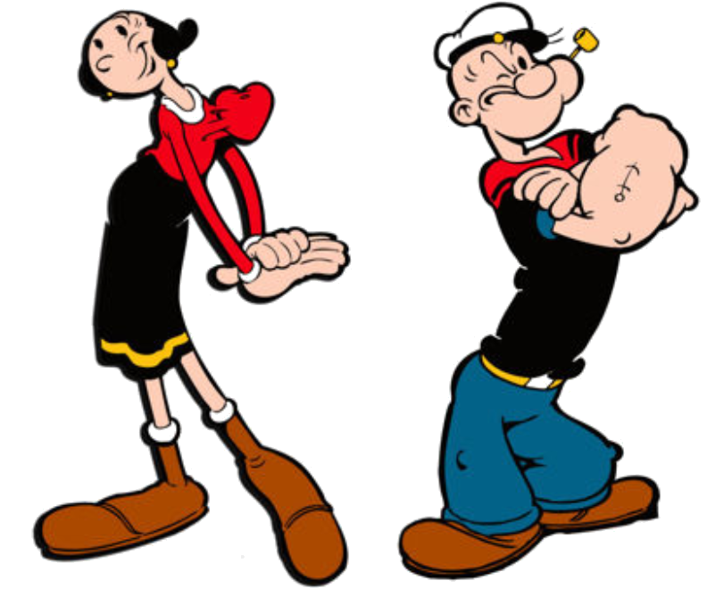
pepaya
I don’t think Popeye would be too interested in “pepaya”, though, as he has been known to survive on an exclusive diet of Olive Oyl and spinach.

