Slide 2
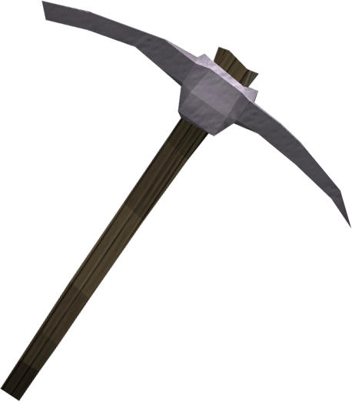
pikir

Slide 3
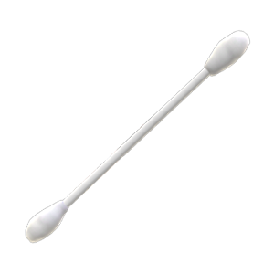
pikir
I know what you’re thinking, but “pikir”, pronounced “pick-ear”, does not mean to clean your ear canal with a pickaxe!
You might be relieved to know that for that task, Indonesians, like us, use cotton buds!

Slide 4
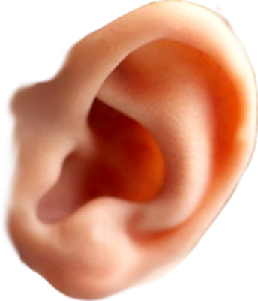
pikir
How on earth does he think up these weird ideas ??? I give up trying to figure him out!
“pikir” actually means “think” so I urge you to “pikir” twice if you still want to use a pickaxe to clean your ear.
If you still insist on being stubborn, at least “pikir” about using a very small one to do the job.

