Slide 2
tentang

Slide 3
tentang
You could be forgiven for thinking that “tentang”, pronounced “ten-tongue”, actually means “ten tongues” or someone who is a “polyglot” (speaks ten or more languages).
In fact, it is much simpler than that! The word “tentang” means “about” in the sense of “on the subject of …”. For example, “Let’s talk about …” .

Slide 4
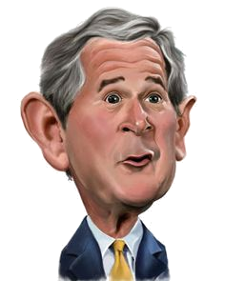
tentang
That’s about it for this one … no more beating about the Bush !

