Slide 1
Using authentic materials
In Year 7-12 secondary
Indonesian classes

Slide 2
Why do we need to use authentic materials?
What kind of authentic materials make good tasks?

Slide 3
From the teacher’s viewpoint..
What’s good and bad about Using authentic materials?

Slide 4
What are the pros and cons of
using authentic texts with
lower secondary classes?

Slide 5
Berita bagusnya …
there are HEAPS of
materials available
online

Slide 6
Bahan-bahan tertulis:
website film
website selebriti
website televisi
blog
surat kabar
majalah
lagu/lirik
iklan
artikel berita
komik
forum
website NGO
website
pemerintah
DLL……

Slide 7
Bahan-bahan video/audio
lagu
film
chat show
acara radio
siaran berita
sinetron
reality TV
kartun
iklan
wawancara
Dokumenter
DLL…..

Slide 8
Kita mulai di mana?

Slide 9
PILIH
CARI
The process …
CIPTAKAN
PUTUSKAN
BENTUKNYA

Slide 10
CARI
topic?
text type?
what’s out there?

Slide 11
CARI
… and here’s a bit of searching I did earlier ….
with Year 7-10 in mind

Slide 12
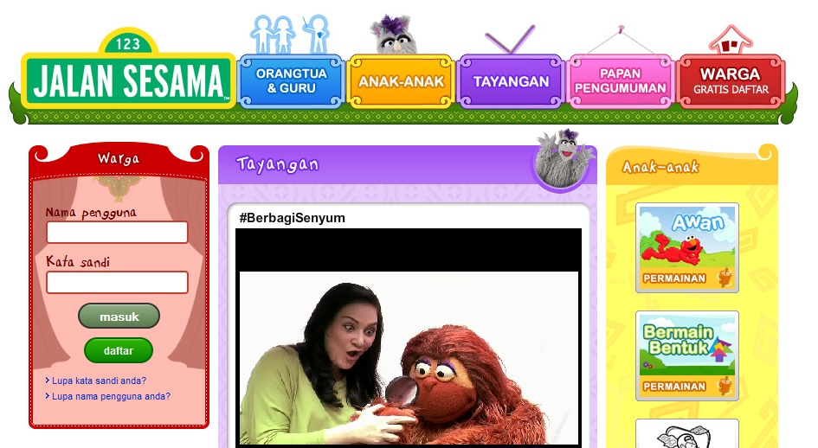
TV show websites
e.g. www.jalansesama.or.id

Slide 13
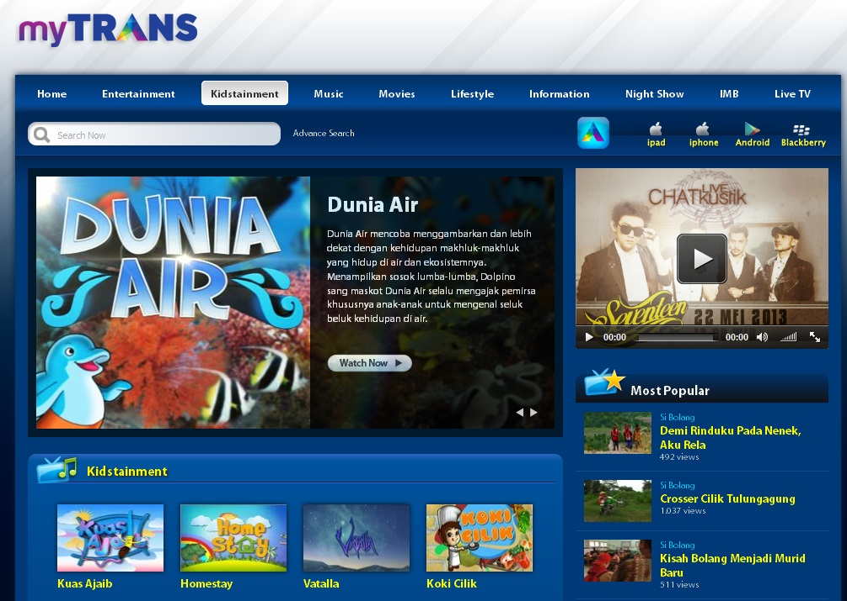
http://us.mytrans.com/kanal/48/kidstainment

Slide 14
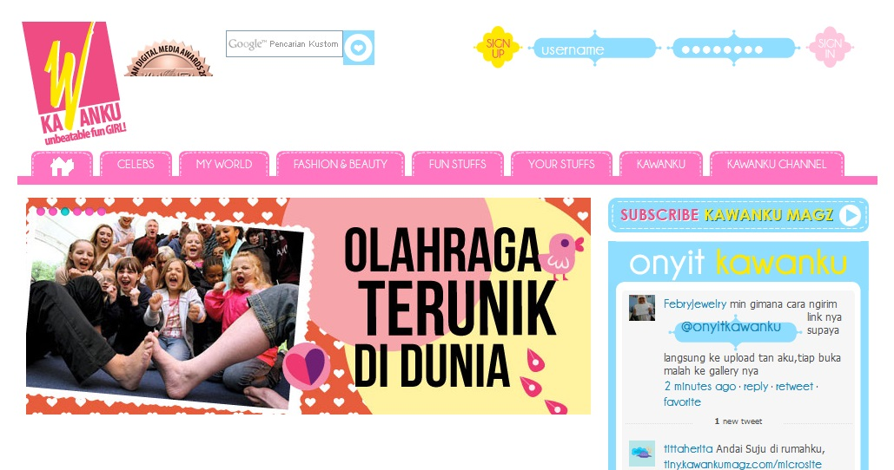
online teen magazines e.g.
www.kawankumagz.com

Slide 15
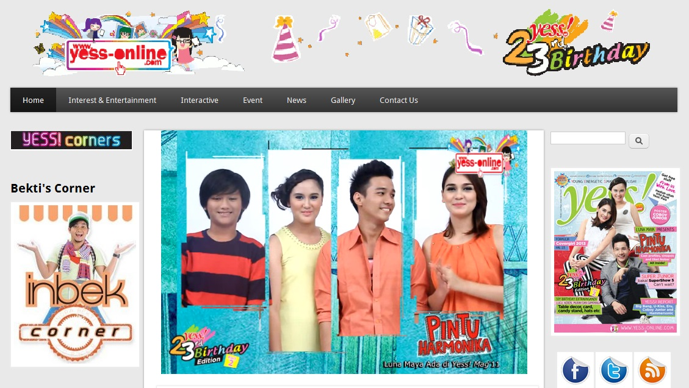
yess-online.com

Slide 16
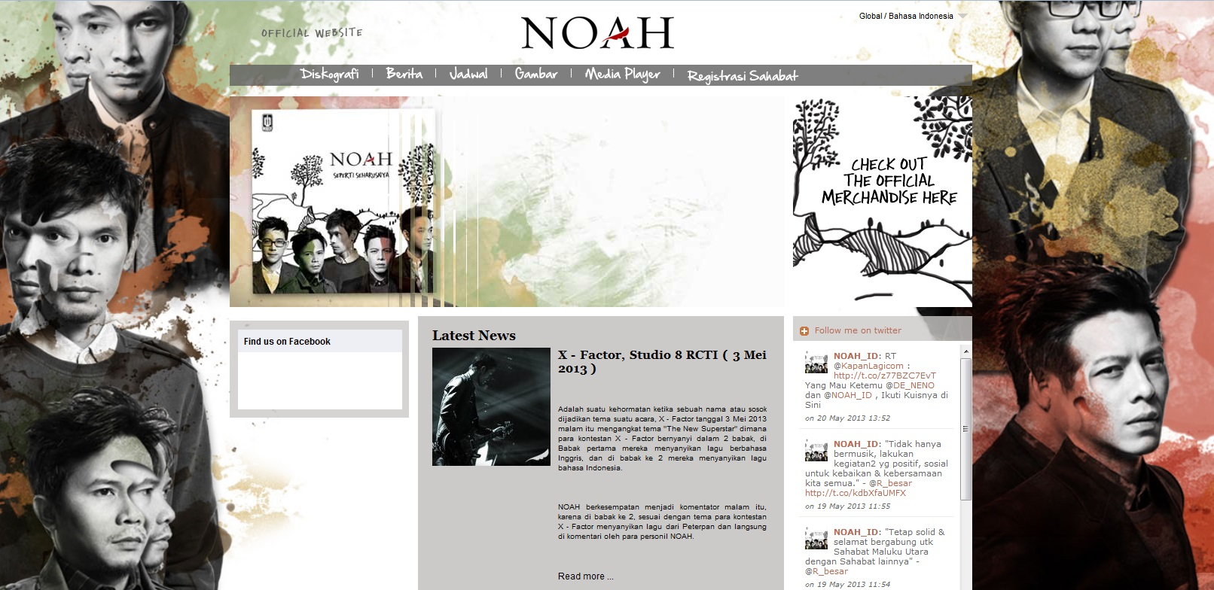
websites of bands or singers
e.g. www.noah-site.com

Slide 17
www.cherrybelle.info

Slide 18
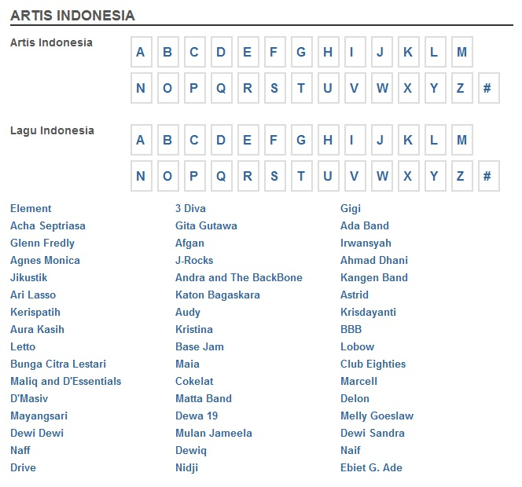
song lyrics sites e.g.
lirik.kapanlagi.com

Slide 19
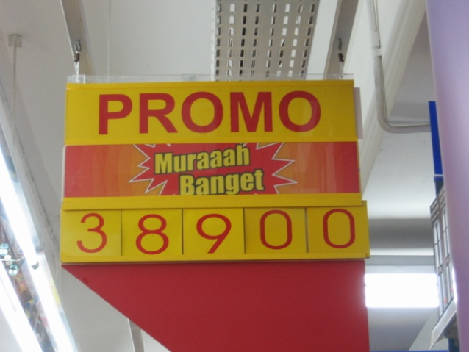
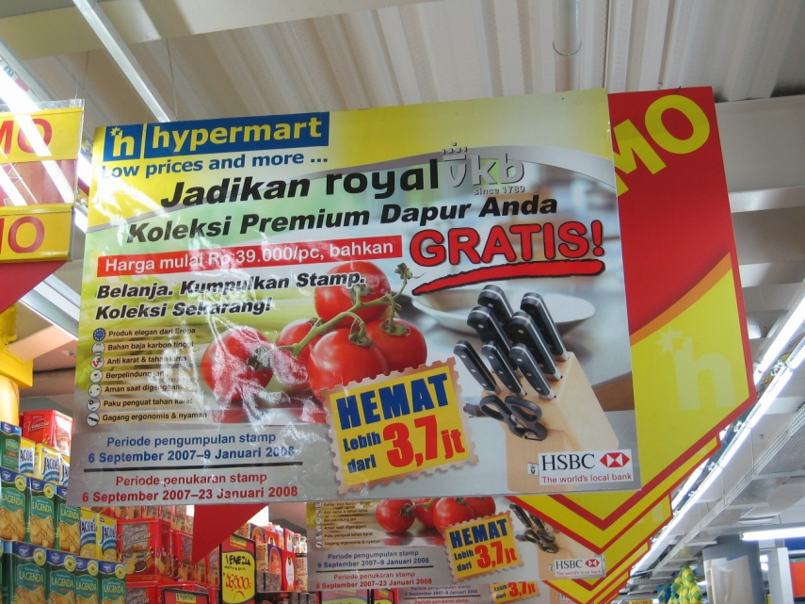
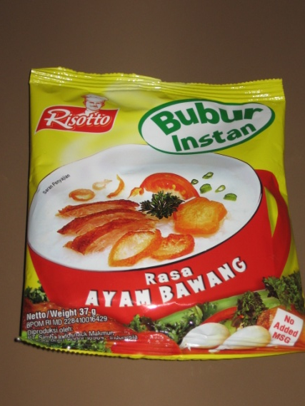
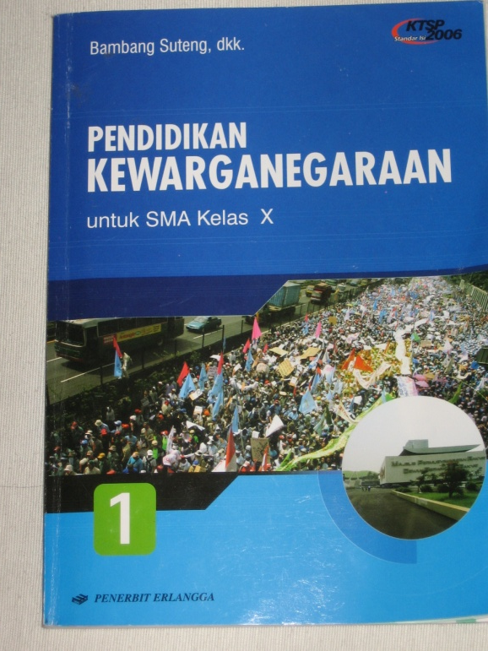
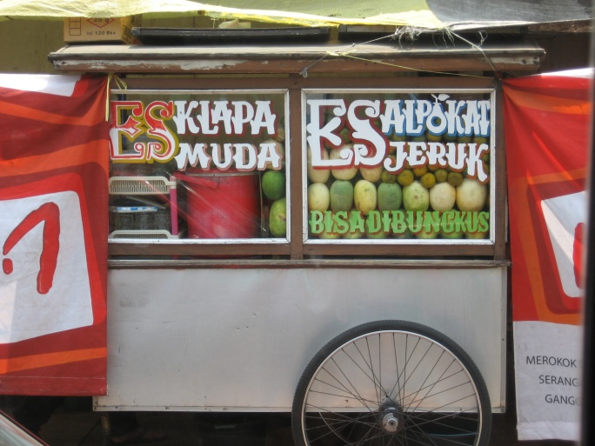
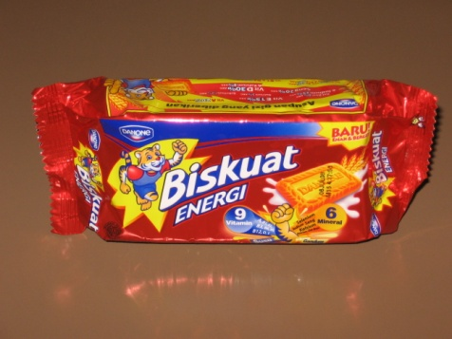
your own photos & realia

Slide 20
YouTube! (if desired, download with
KeepVid or Download Helper for Firefox)
film trailers & excerpts
advertisements
music video clips (and
karaoke)
TV show excerpts
documentaries

Slide 21
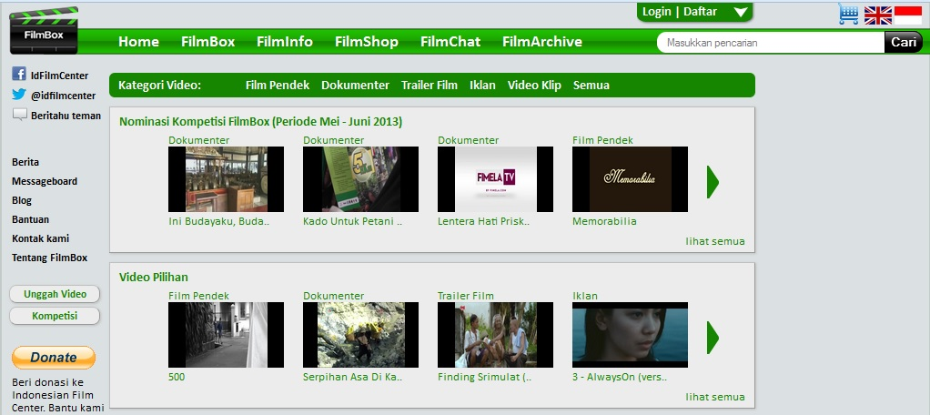
Indonesian Film Centre
www.indonesianfilmcentre.com

Slide 22
PILIH
Find a text that …
looks interesting/engaging
matches the topic
offers observational under-
standing as well as textual

Slide 23
PUTUSKAN BENTUKNYA
as an electronic resource?
as a hard copy?

Slide 24
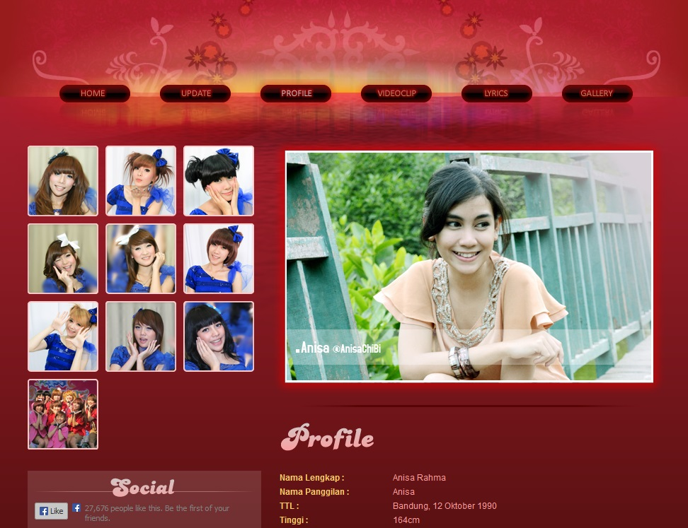
Use as is (electronically)?

Slide 25
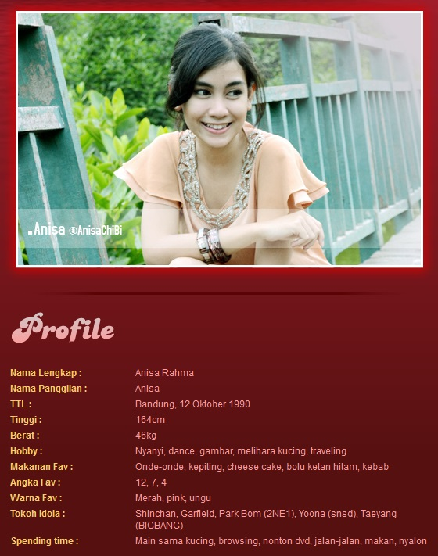
… or use as
the basis for
a hard copy
task?

Slide 26
Obviously ….
Written texts may be copied
and modified if desired (but
preferably not!)
Video texts have to be used
as is

Slide 27
http://www.youtube.com/watch?v=1CBjZs0bT6A
http://www.youtube.com/watch?v=FwlKSKdsLG4
http://www.youtube.com/watch?v=0gKkSr6dQkg
http://www.youtube.com/watch?v=VUVIzF7UQ64
http://www.youtube.com/watch?v=ISgDp_aDVP8
http://www.youtube.com/watch?v=PTwOnWEd55E
http://www.youtube.com/watch?v=z_1M1Ve8NuM

Slide 28
CIPTAKAN
Try to use a range of unmodified and modified texts
Create a well-structured task

Slide 29
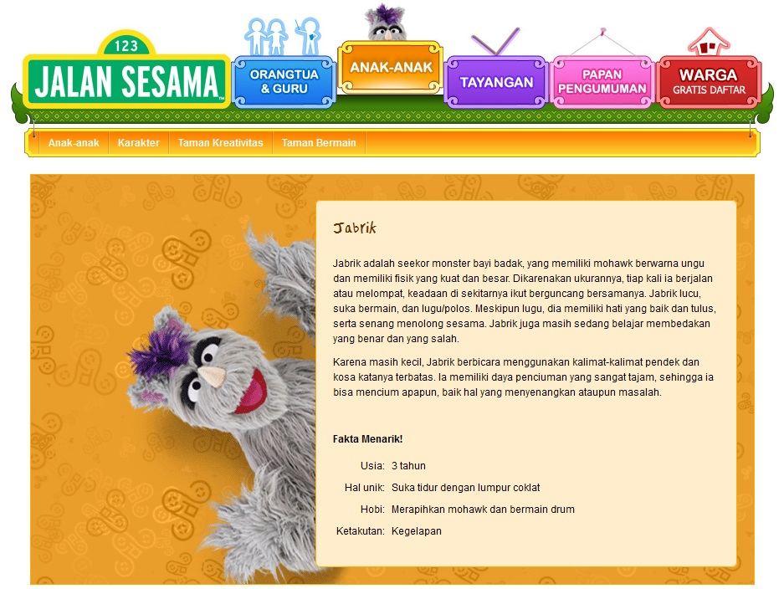
Linguistic features: (one of) Compare ber- and me- verbs; usage of “yang” with adjectives; usage of conjunctions; usage of “adalah” with nouns but not adjectives.
While-reading tasks: (1) Underline the words that mean baby, purple, big, strong etc. (2): Jabrik wants to go on exchange to Sesame Street in the USA. Use the vocabulary list to help you understand the description and help him complete his application in English.
Animal: Fur Colour: Personality: Age: Likes/dislikes: Hobbies: Other information:
Intercultural understandings?
After-reading task:
Design a new member of Jalan Sesama and write his/her/its Fakta Menarik in Indonesian.
Pre-reading task(s):
(1) Learning how to describe people and animals (2) describing your favourite cartoon character

Slide 30
Example of task structure:
BEFORE –students meet and learn language they will need
DURING – students read/ view, notice, understand and respond to show understanding
AFTER – students use know-ledge for own productive task

Slide 31
Why?
Sharing your materials
with other teachers??
How?

Slide 32
What is good about sharing
things we create?
get useful feedback
get more ideas
can share a useful raw text
help build up resource stock

Slide 33
ngomong-ngomong, gimana kalau kita tukar dan bagikan bahan-bahan yang kita ciptakan … oke?
Boleh saya minta Julie untuk membaca bahan-bahan saya dan memberi komentar atau saran? Saya kurang pasti kalau cocok …
Tentu saja boleh Jill. Ayo kita kerja sama!

Slide 34
How? Via wiki is one option.
http://indonesian2ab.wetpaint.com
http://indonesian3ab.wetpaint.com/
Or there’s Dropbox.
http://www.dropbox.com

Slide 35
Authentic materials in
Year 11-12

Slide 36
Syllabus
Teaching programme
Learning contexts
Prescribed topics
Text types (for learning & assessment)
Linguistic resources
Intercultural understandings
Assessment

Slide 37
Program pengajaran 3A saya
Wacana: apa itu?
Kegemaran membaca dan menonton remaja Indonesia
Media massa Indonesia
Social media Indonesia
Televisi Indonesia
Sejarah penyensoran media Indonesia
Film Indonesia

Slide 38
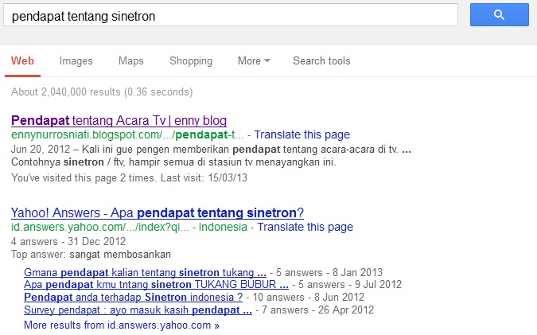
CARI

Slide 39
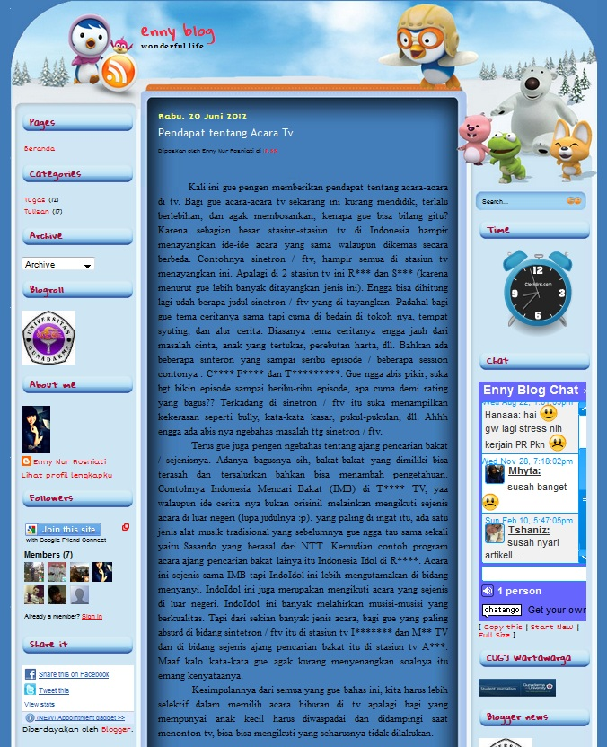
PILIH

Slide 40
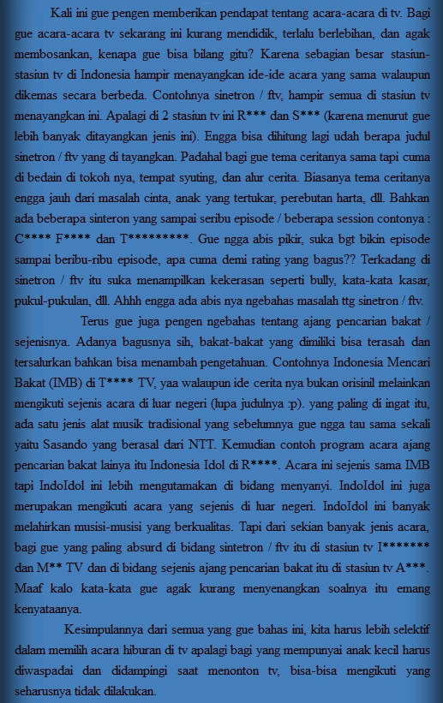
PILIH

Slide 41
PUTUSKAN BENTUKNYA
Perfect for my next reading
assessment!
CIPTAKAN
It’s going to need quite a bit
of modification…

Slide 42
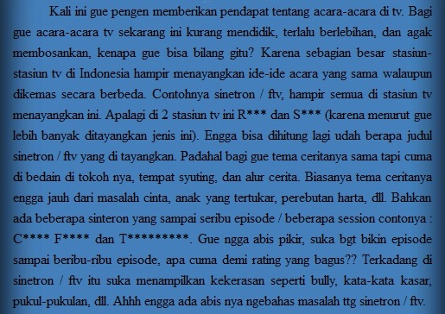

Slide 43
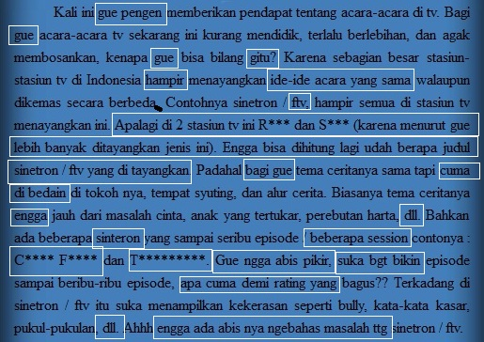

Slide 44
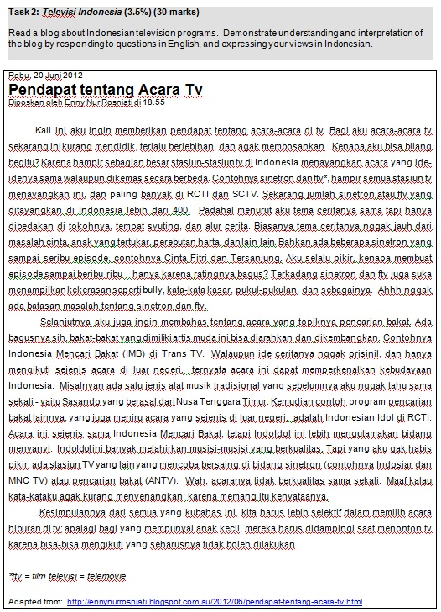

Slide 45
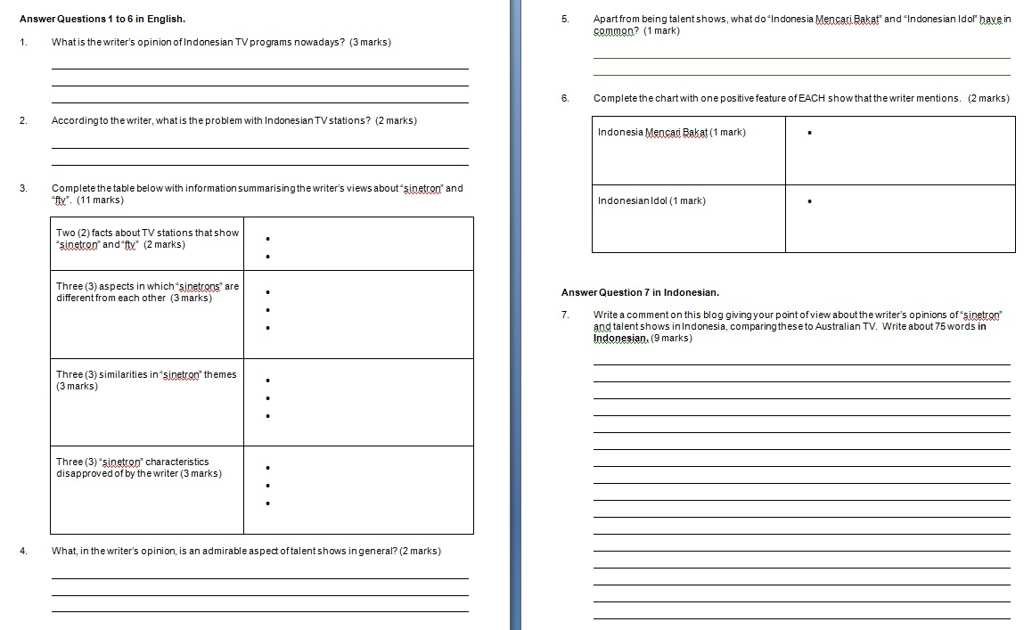

Slide 46
Finding things by accident

Slide 47
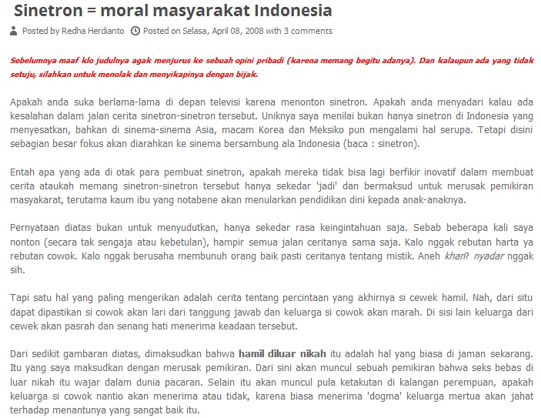

Slide 49
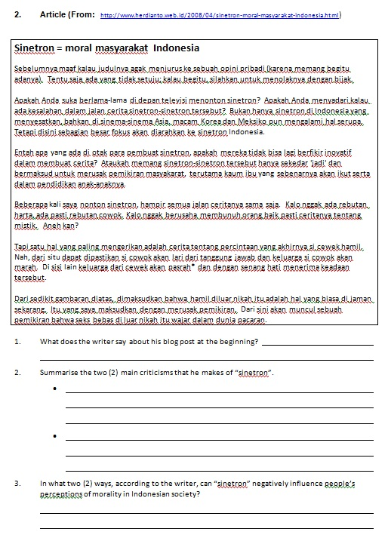

Slide 50
Maaf, waktunya habis!

