Slide 2
warna

Slide 3
warna
No, “warna” pronounced “wahr-nah”, has nothing to do with Warner Bros. Studios, except that people who cannot roll their “r”s pronounce it the same way!
The word “warna” actually means “colour” in Indonesian.

Slide 4
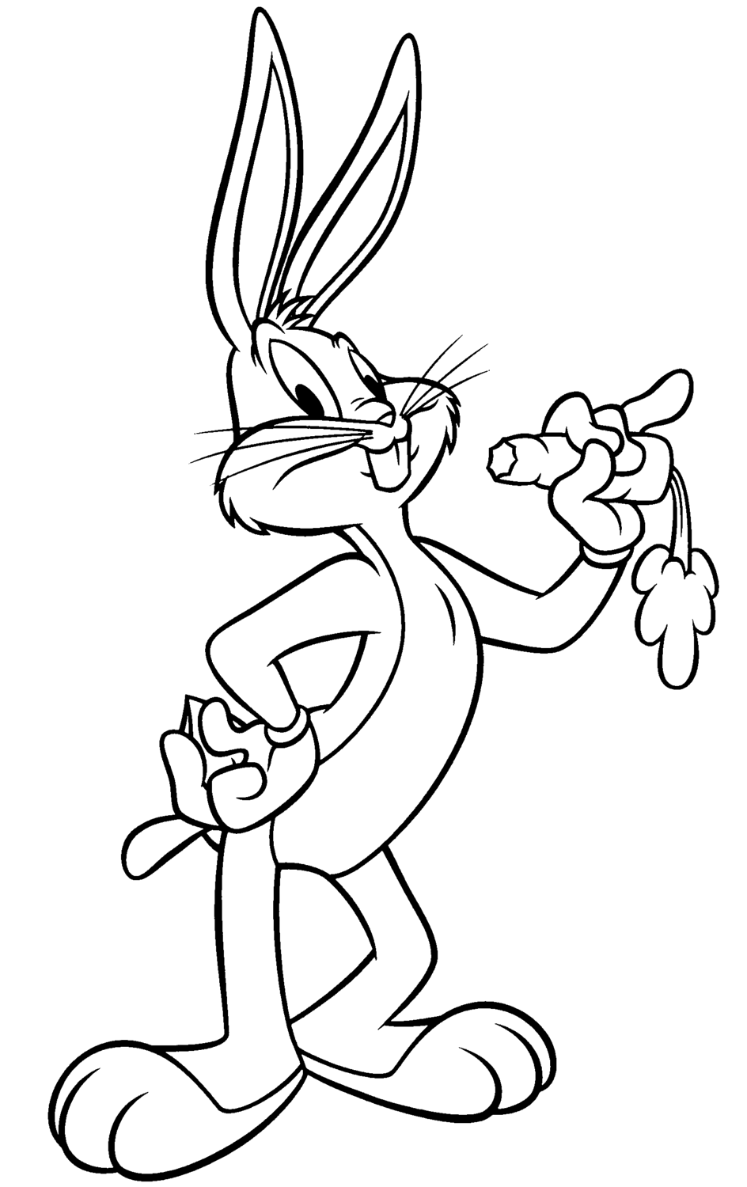
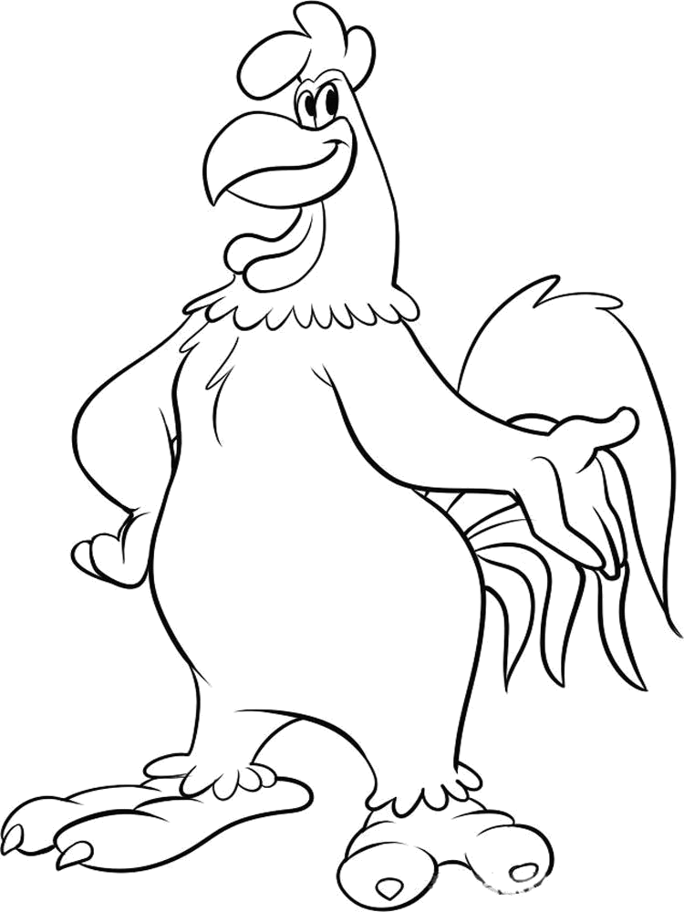
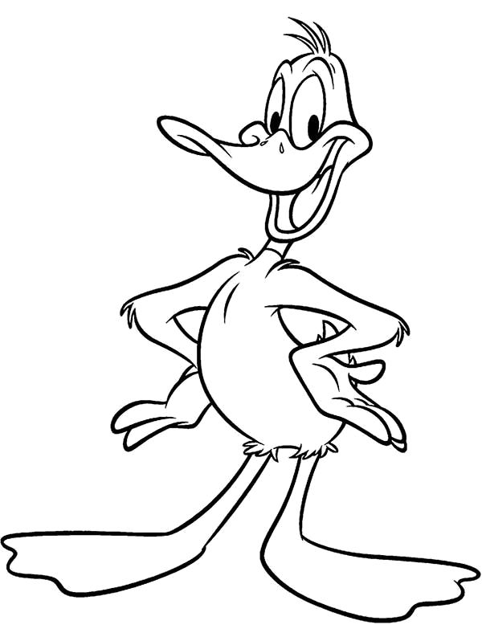
warna
If you want to colour your world, you can start with the pictures below:

Slide 5
warna

